Slide 1

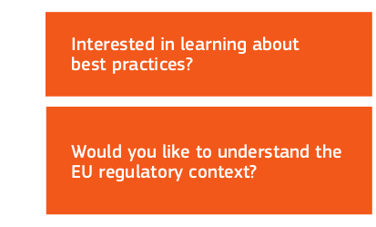
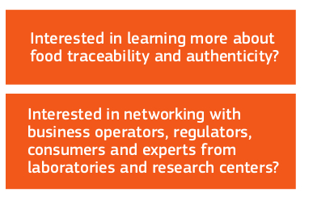


Slide 2


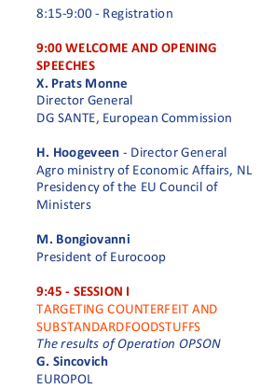
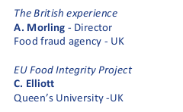
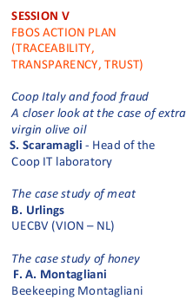

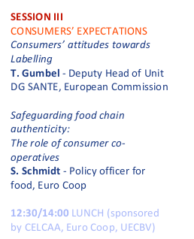


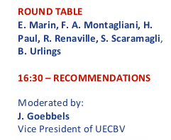
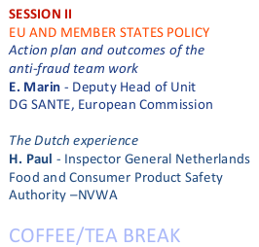

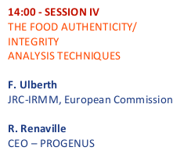

Slide 3
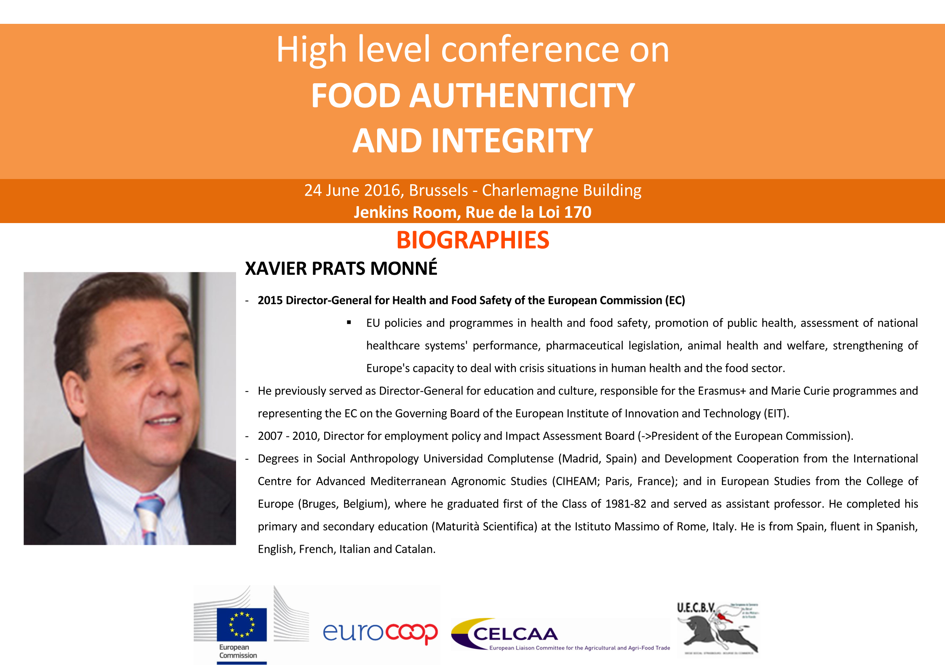

Slide 4
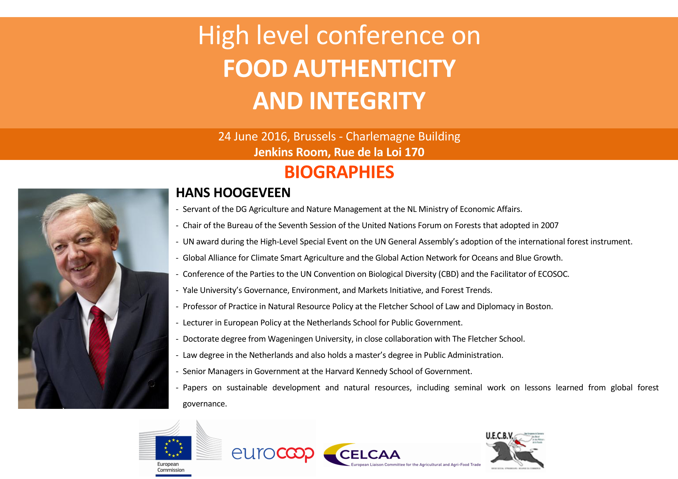

Slide 5
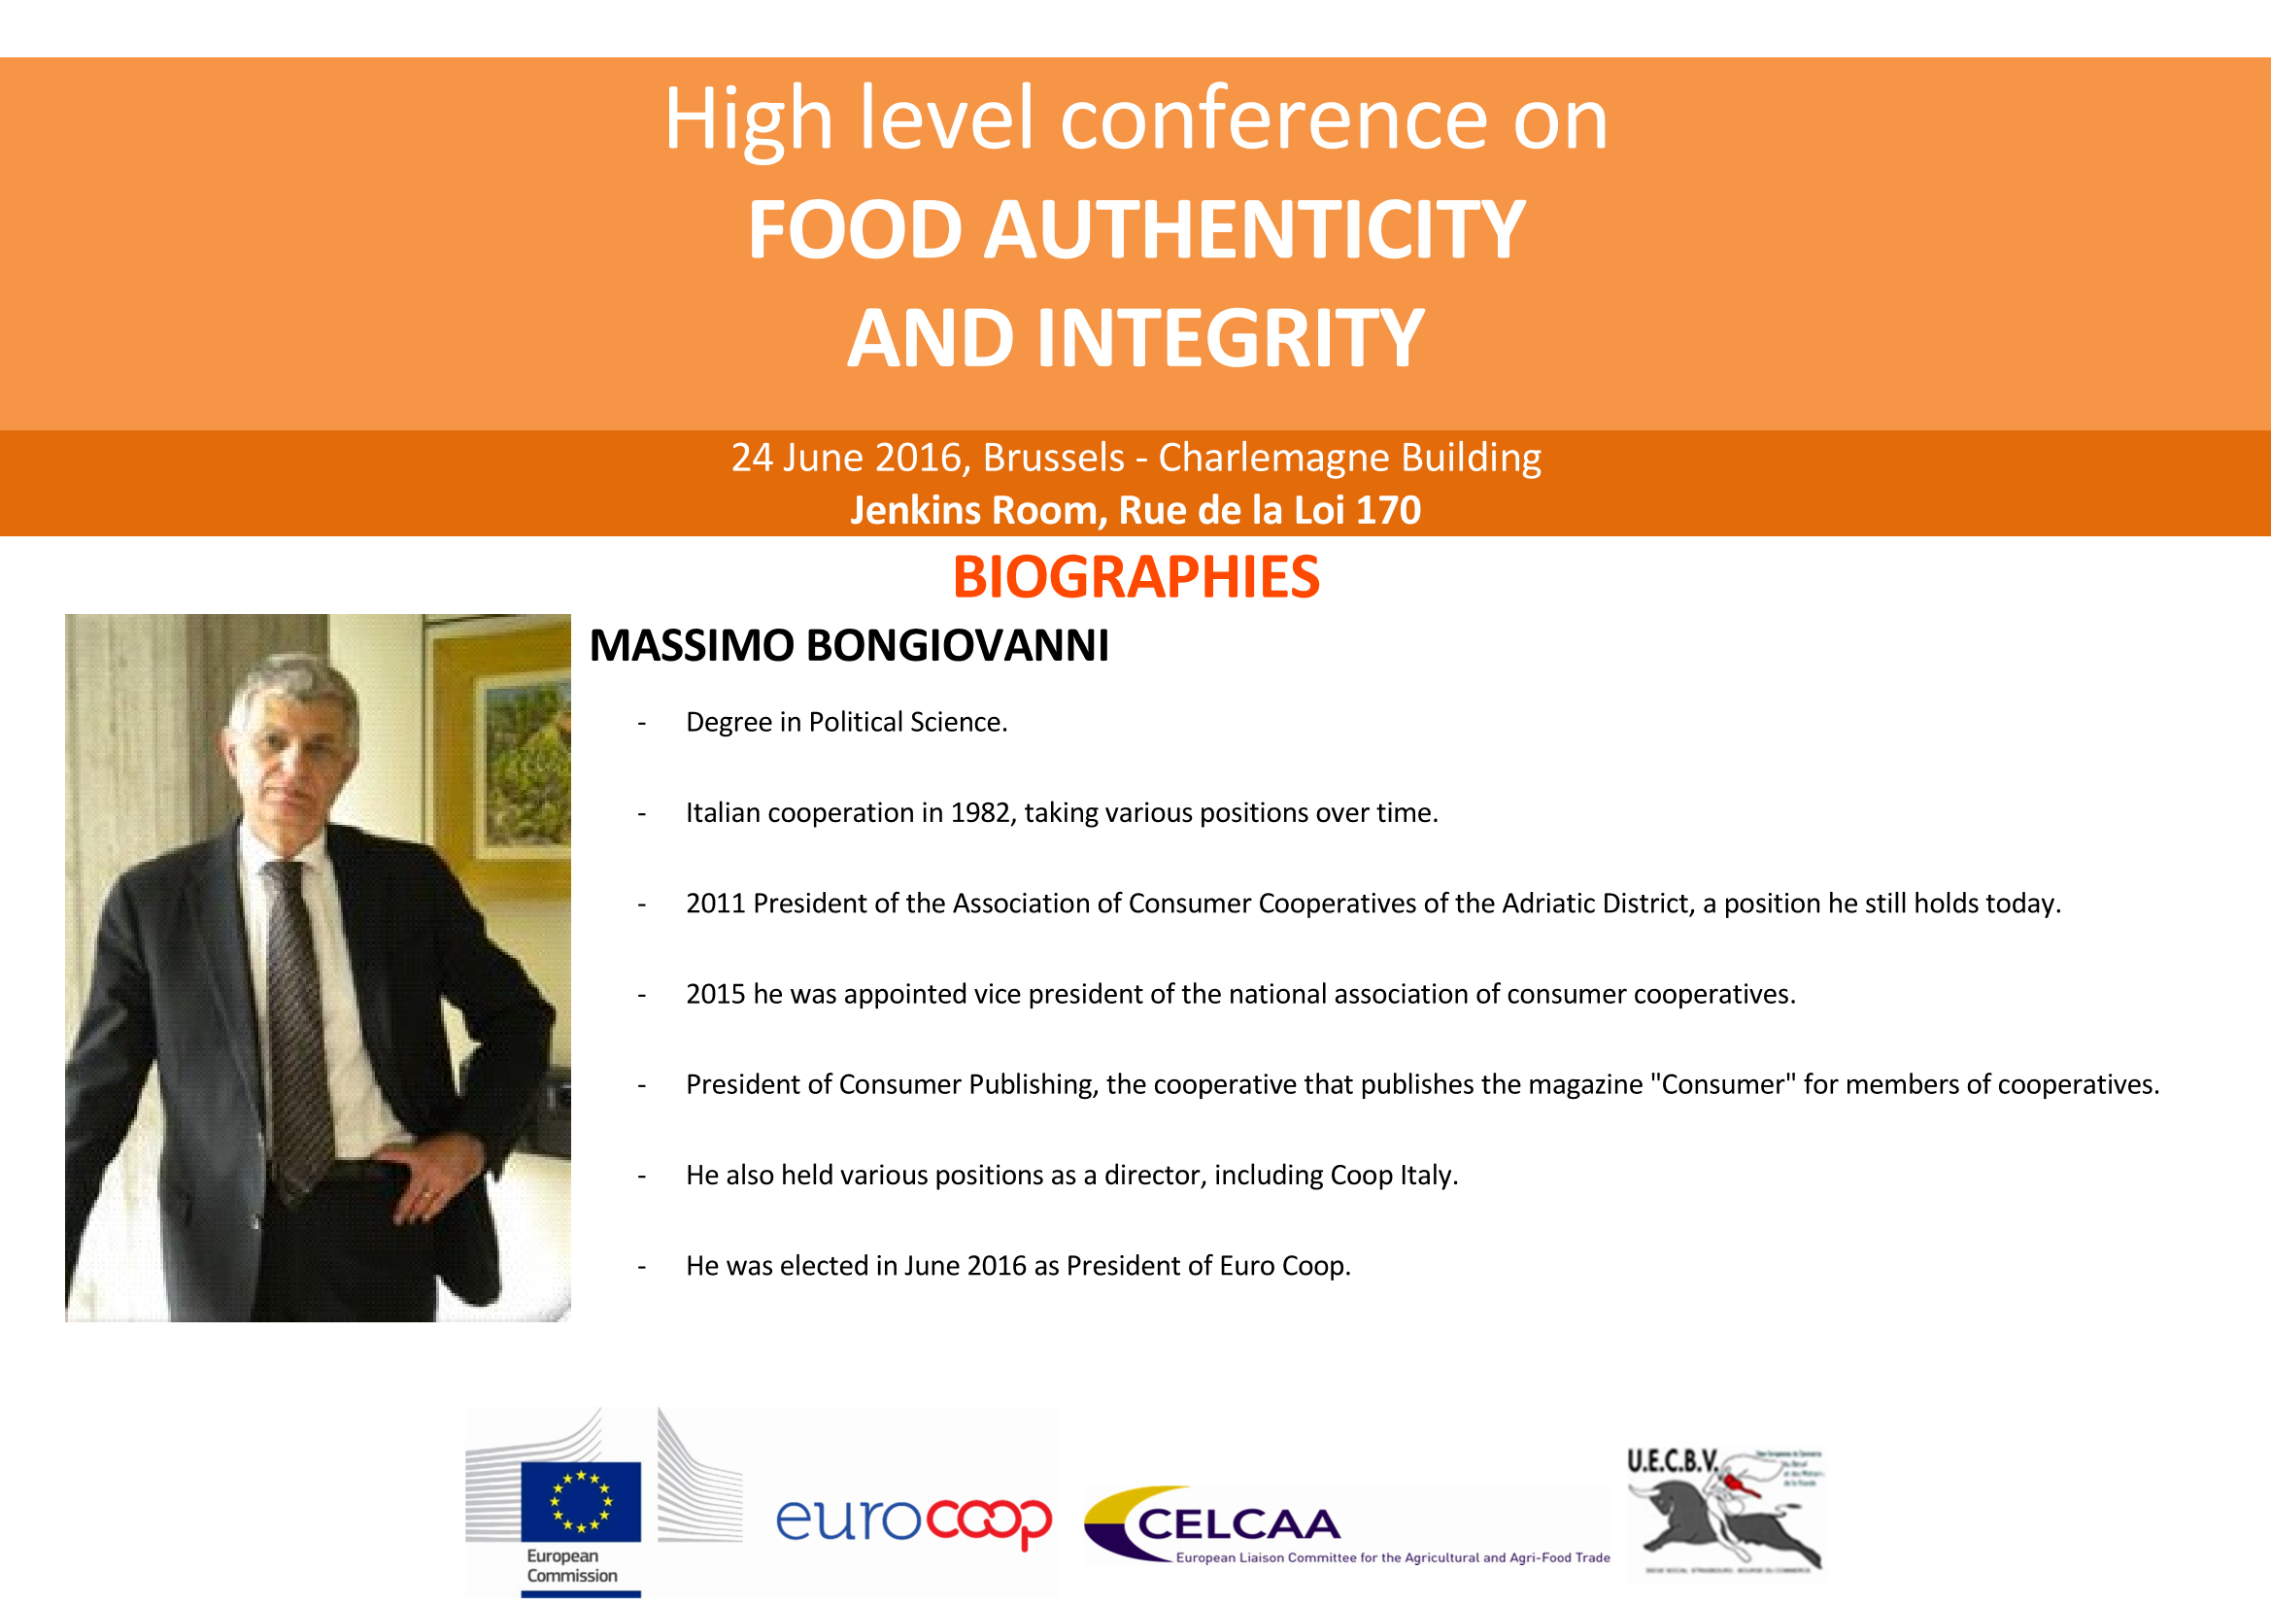

Slide 6
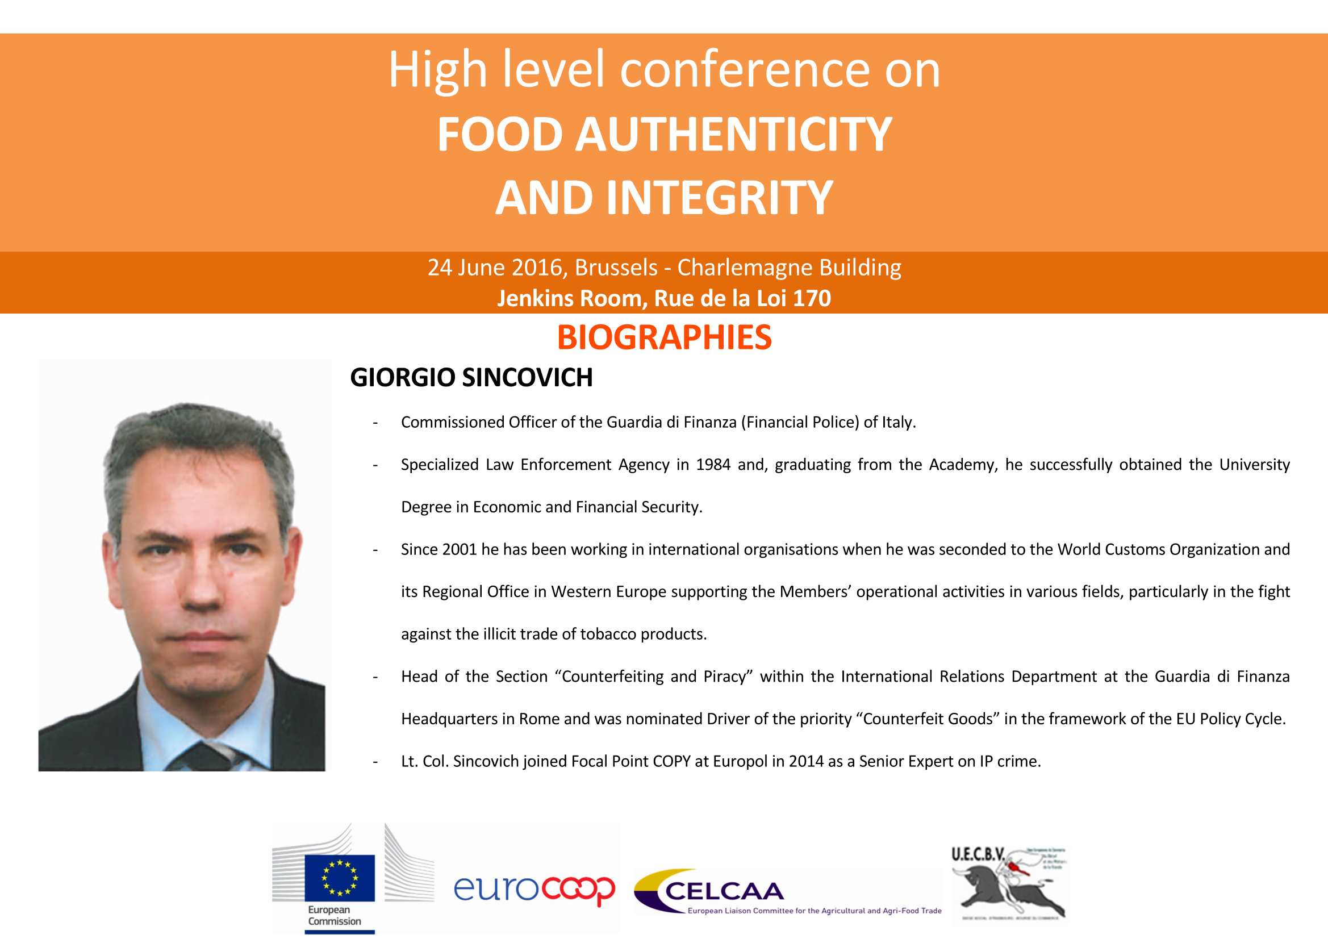

Slide 7
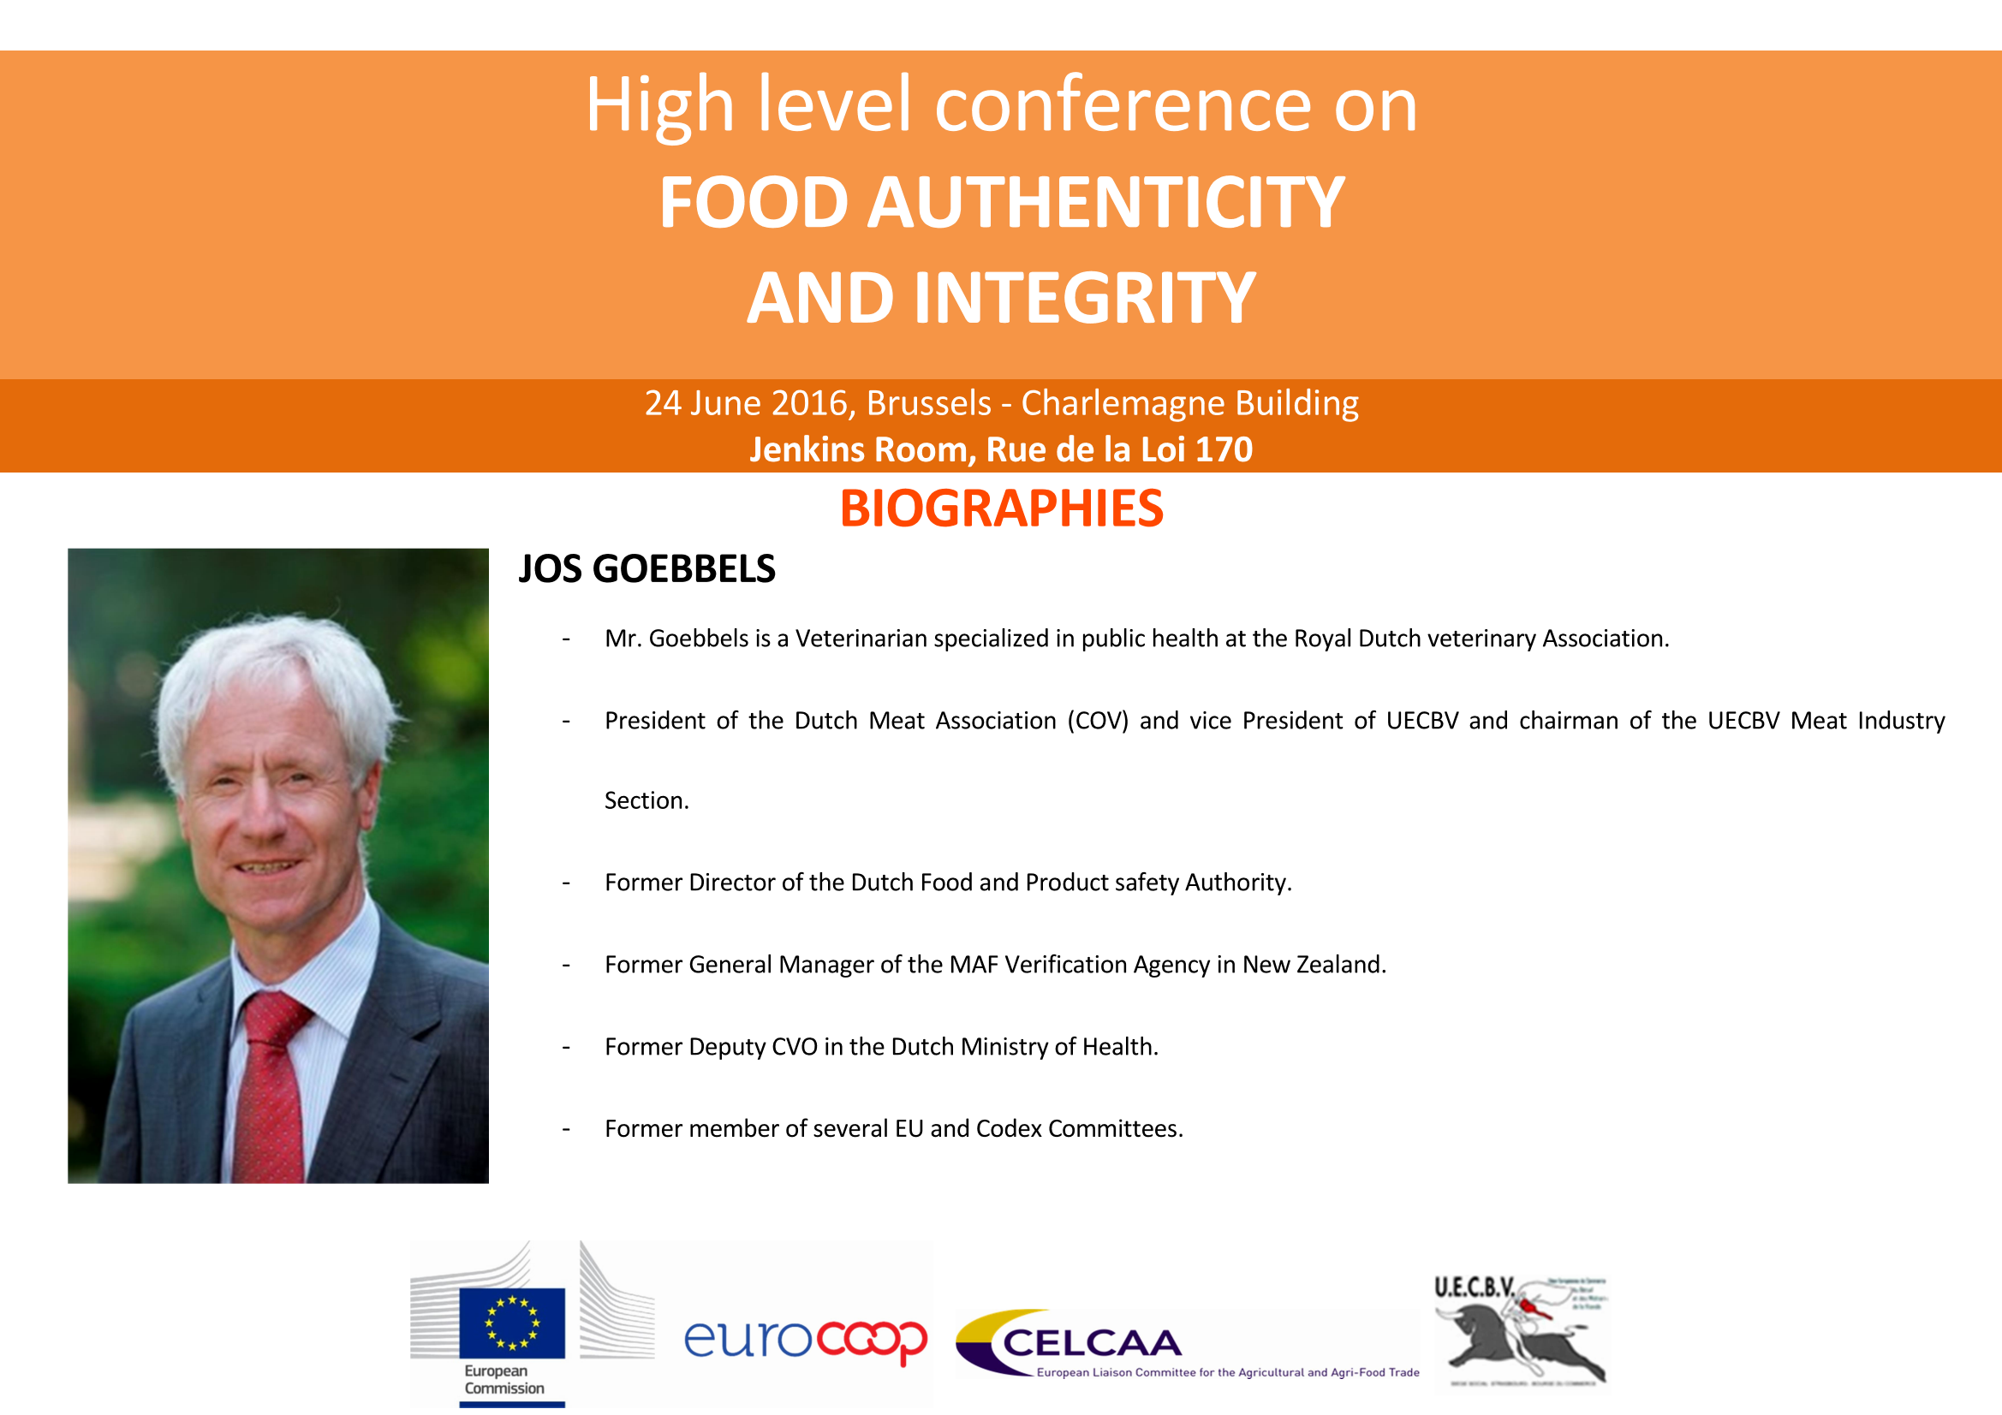

Slide 8
The results of Operation OPSON
High Level Conference
“Food Authenticity and Integrity”
Brussels, Belgium
24 June 2016
EUROPOL UNCLASSIFIED – BASIC PROTECTION LEVEL

Slide 9

EUROPOL UNCLASSIFIED – BASIC PROTECTION LEVEL

Slide 10

EUROPOL UNCLASSIFIED – BASIC PROTECTION LEVEL
Food Crime, the beginning...
Italian initiative: April 2010, 1st International Meeting on Counterfeit and Protected Food Products, jointly organised by the Corpo Forestale dello Stato and the Interpol National Central Bureau Rome
Global problem: in 2010, 3 millions items seized at the EU borders (24 cases)
Joint concern EUROPOL & INTERPOL: invitations launched in March 2011
Main Objectives of the joint efforts
Dismantle Organised Crime Groups involved in this area
Raise awareness on the phenomenon - consumers/LEAs
Enhance cooperation between involved stakeholders (LEAs, Food Agencies, PS)
10 countries: 263 tons, 35,700 litres
Notes:
10

Slide 11
EUROPOL UNCLASSIFIED – BASIC PROTECTION LEVEL
Food Crime
Global Phenomenon
Health and Safety
Organized Crime
Notes:
11

Slide 12
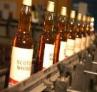
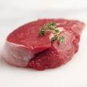

EUROPOL UNCLASSIFIED – BASIC PROTECTION LEVEL
Scope of Food Crime
TYPES OF INFRINGEMENT ON FOOD CRIME
Counterfeiting
e.g. Counterfeit branded
spirits
Substitution
e.g. Horsemeat scandal
Substitution/Adulteration
e.g. Olive oil substituted or diluted with lower-cost oil (nut, sunflower, palm …)

Slide 13
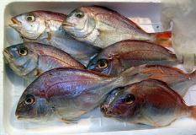

EUROPOL UNCLASSIFIED – BASIC PROTECTION LEVEL
Scope of Food Crime (ctd.)
TYPES OF INFRINGEMENT ON FOOD CRIME (ctd.)
Substitution/Mislabelling
e.g. Substitution of expensive fish with cheaper
Species. Labelled as wild fish but are farmed fish
Modification of seafood product
e.g. Increasing weight (over icing) or use of
unapproved additives
Expired products

Slide 14


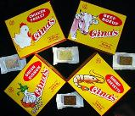


EUROPOL UNCLASSIFIED – BASIC PROTECTION LEVEL
THE OPSON MODEL
Fight against counterfeit/substandard
food and beverages

Slide 15
EUROPOL UNCLASSIFIED – BASIC PROTECTION LEVEL
OPSON - Objectives
Fight against OCG involved in food crime
Protect public health
Enhance inter-agency cooperation
Enhance international cooperation
Improve public/private cooperation
Notes:
15

Slide 16
EUROPOL UNCLASSIFIED – BASIC PROTECTION LEVEL
How to achieve collective success?
Inter-agency partnership
International cooperation
Sharing-
Exchange of information
Public-private sector cooperation
Notes:
16

Slide 17
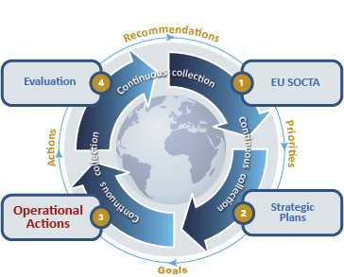
EU Policy Cycle – 2014/2017
EUROPOL UNCLASSIFIED – BASIC PROTECTION LEVEL
https://www.europol.europa.eu/content/eu-policy-cycle-empact
http://www.youtube.com/watch?v=l5en24omjqM

Slide 18


EUROPOL UNCLASSIFIED – BASIC PROTECTION LEVEL
EMPACT – “Counterfeit Goods”
“Promoting the multidisciplinary approach by linking EU LEAs with DG SANTE training courses”

Slide 19
EUROPOL UNCLASSIFIED – BASIC PROTECTION LEVEL
OPSON V – Participating countries
(57)
EU Countries
Non EU Countries
Austria, Belgium, Bulgaria, Croatia, Czech Republic, Denmark, Estonia, Finland, France, Germany, Greece, Hungary, Ireland, Italy, Latvia, Lithuania, Luxembourg, the Netherlands, Portugal, Romania, Spain, Sweden, United Kingdom
Africa
Burundi, Comores, Côte d’Ivoire, Eritrea, Kenya, Nigeria, Rwanda, Seychelles, South Sudan, Sudan, Tanzania, Togo, Zambia
America
Argentina, Bolivia, Colombia, Ecuador, Peru, Uruguay, USA
Europe
Albania, Belarus,
Bosnia and Herzegovina, Iceland, Turkey, Norway, Russia
Asia
Australia, Fiji, Indonesia, Korea, Thailand, Vietnam
Middle East
Jordan
Notes:
19

Slide 20















EUROPOL UNCLASSIFIED – BASIC PROTECTION LEVEL
OPSON V – Private Sector Partners
CIVC
Colgate Palmolive
Consorzio di Tutela Gorgonzola
Consorzio di Tutela Prosecco
Unaprol Consorzio Olivicolo Italiano
Ferrero Spa
IFSP
Moët Hennessy
Nestlé
REACT
Danone
Consejo Regulador de Tequila
Scotch Whisky Association
The Coca Cola company
GSK
Unilever
Red Bull
Mars
Mondelez
Notes:
20

Slide 21
EUROPOL UNCLASSIFIED – BASIC PROTECTION LEVEL
Figures* OPSON: V (IV) Global, V [EU]
Tons 11,100
(11,600)
[10,200]
Liters
1,500,000
(814,000)
[601,000]
Pieces 5,500,000
(1,234,000)
[920,000]
Final report will be presented at debriefing meeting in Spain in October 2016
*Ongoing review

Slide 22
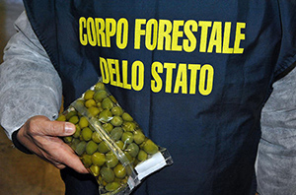
EUROPOL UNCLASSIFIED – BASIC PROTECTION LEVEL
Opson Cases
Italy
Olives colored with copper sulphate

Slide 23
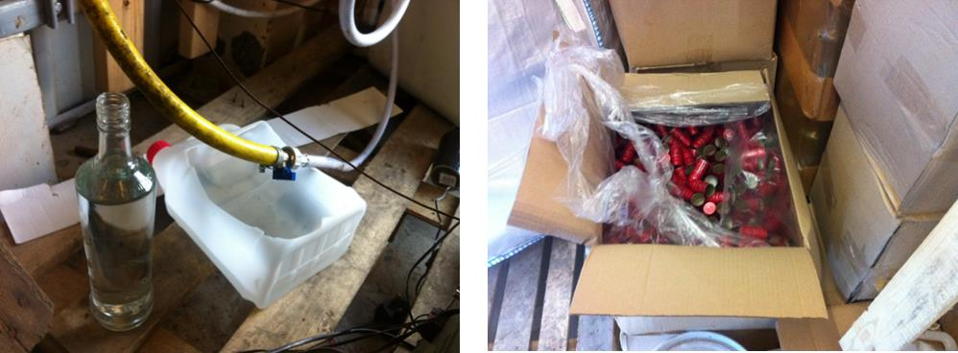
EUROPOL UNCLASSIFIED – BASIC PROTECTION LEVEL
Opson Cases
Greece, Italy, UK
Illicit production sites of spirits
Counterfeit or adulterated spirits

Slide 24
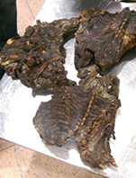
EUROPOL UNCLASSIFIED – BASIC PROTECTION LEVEL
Opson Cases
Belgium, France
Illicit products with international travellers

Slide 25
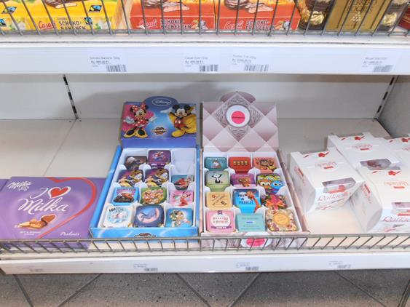
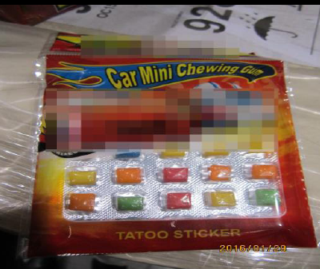
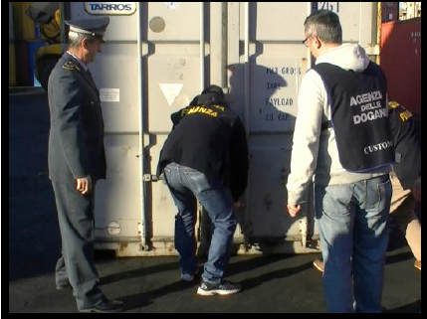
EUROPOL UNCLASSIFIED – BASIC PROTECTION LEVEL
Opson Cases
Italy, Hungary, Lithuania, Romania
Food intended for children

Slide 26
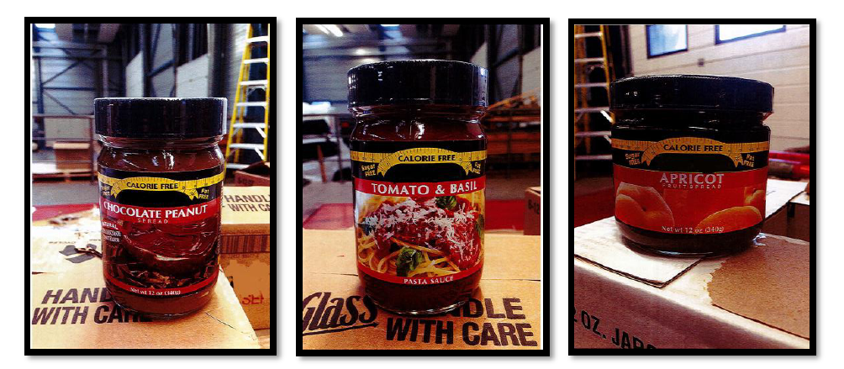
EUROPOL UNCLASSIFIED – BASIC PROTECTION LEVEL
Opson Cases
Belgium
Dietary products

Slide 27
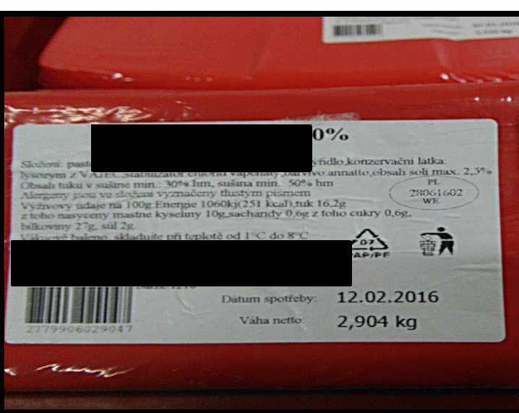
EUROPOL UNCLASSIFIED – BASIC PROTECTION LEVEL
Opson Cases
Czech Republic
Counterfeit cheese

Slide 28
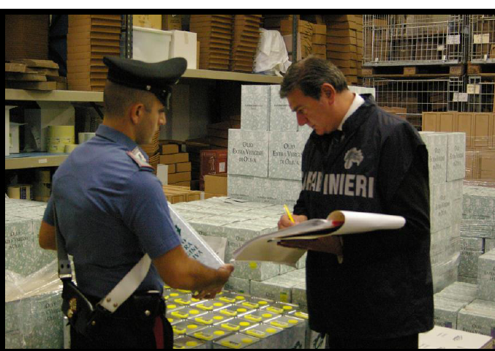
EUROPOL UNCLASSIFIED – BASIC PROTECTION LEVEL
Opson Cases
Italy
Olive oil

Slide 29
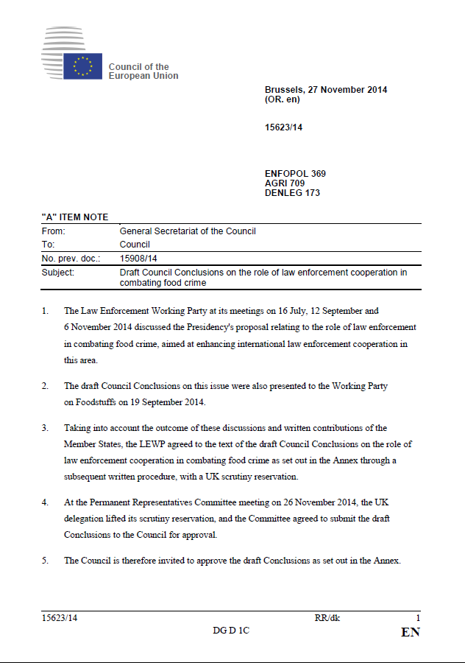
Thank you
Subproject on food crime within
FP COPY at Europol
(Intellectual Property Crime Coordinated Coalition - IPC³)

Slide 31
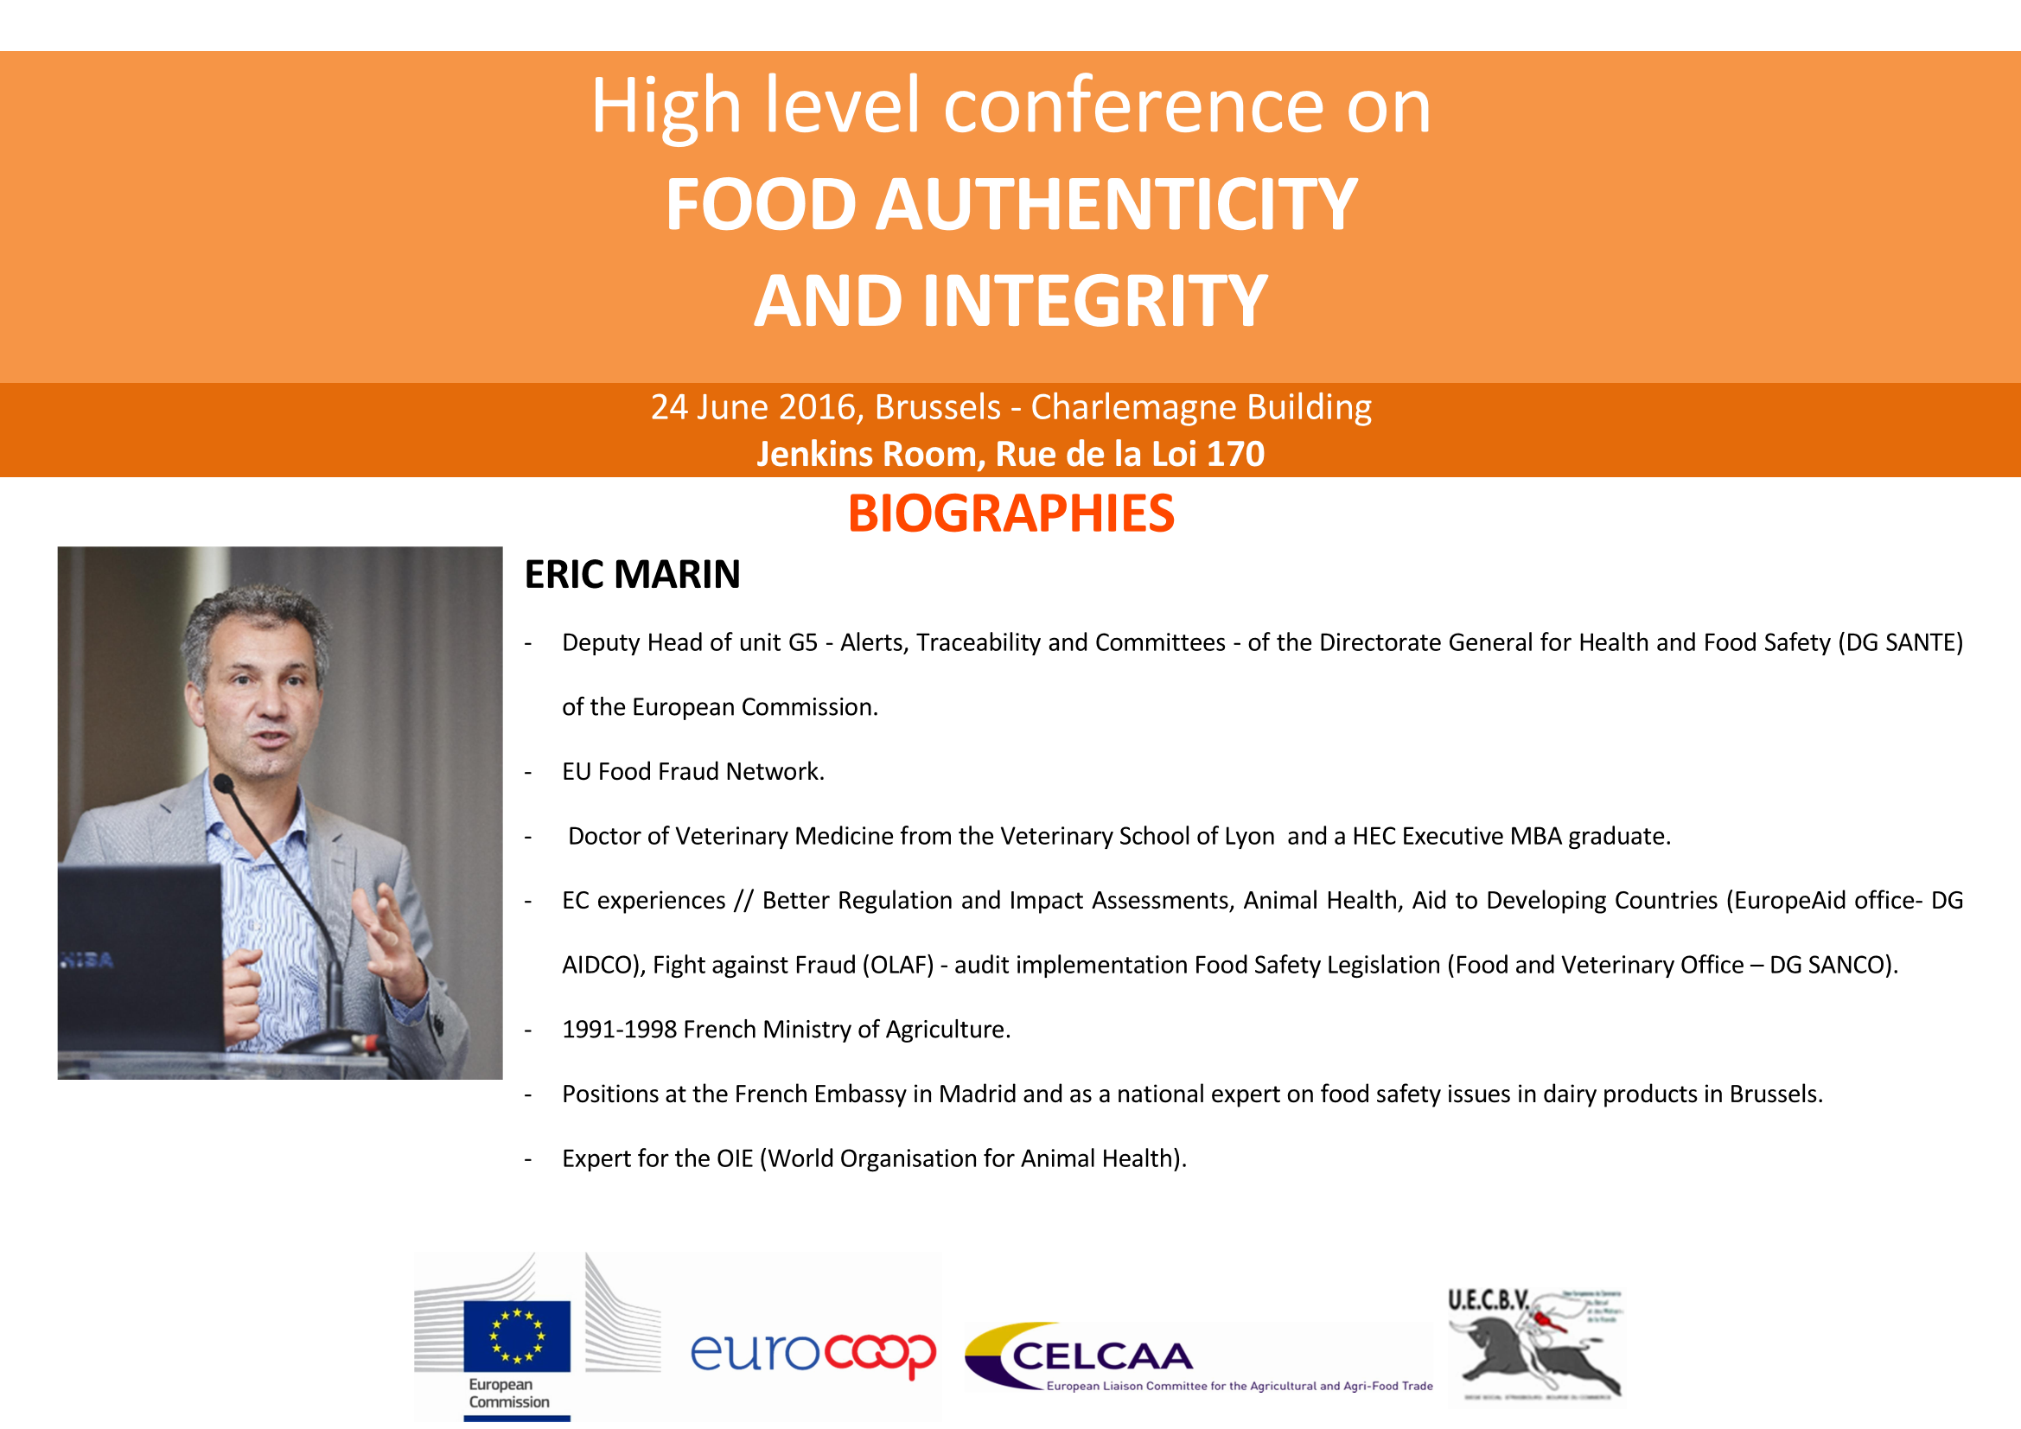

Slide 32







EU FIGHT AGAINST
FOOD FRAUD
DG SANTE
Unit G5 – Alerts, Traceability and Committees
Eric Marin

Slide 33











FOOD FRAUD
 |  |  |  | Confidence
Impact on Consumer
• No EU definition
• Four key criteria:
1. Violation of EU Food Law
2. Intention
3. Economic gain
4. Deception of customers
Fraudsters have no
interests in creating
public health incidents!

Slide 34
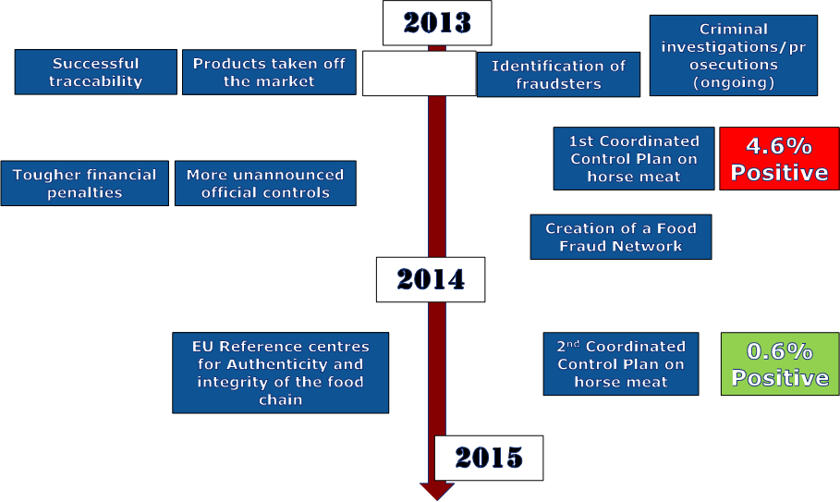
February-
April
March-June
May
July
April-July

Slide 35
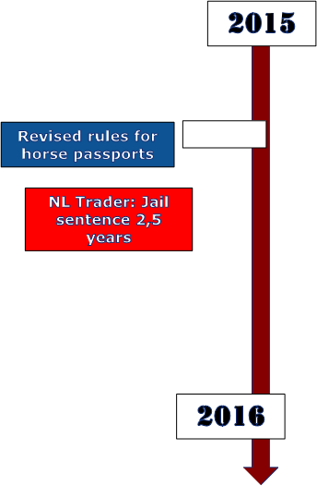
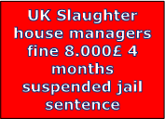









February
March
April
November
December
EU-Coordinated
Cases

Slide 36
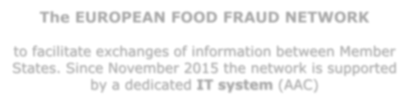







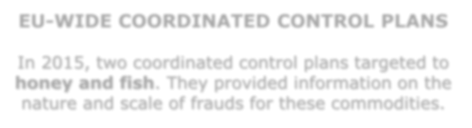




CURRENT INITIATIVES
Dedicated activities have started in 2013
The EUROPEAN FOOD FRAUD NETWORK
to facilitate exchanges of information between Member
States. Since November 2015 the network is supported
by a dedicated IT system (AAC)
EU-WIDE COORDINATED CONTROL PLANS
In 2015, two coordinated control plans targeted to
honey and fish. They provided information on the
nature and scale of frauds for these commodities.

Slide 37
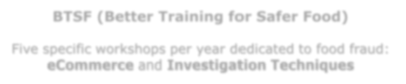





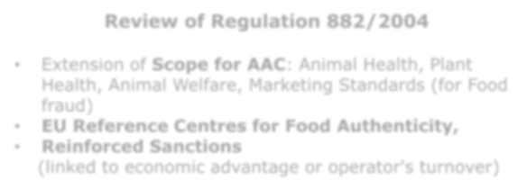


CURRENT INITIATIVES
BTSF (Better Training for Safer Food)
Five specific workshops per year dedicated to food fraud:
eCommerce and Investigation Techniques
Review of Regulation 882/2004
• Extension of Scope for AAC: Animal Health, Plant
Health, Animal Welfare, Marketing Standards (for Food
fraud)
• EU Reference Centres for Food Authenticity,
• Reinforced Sanctions
(linked to economic advantage or operator's turnover)
These initiatives have been welcomed by Member States, MEPs,
consumer organisations and industry

Slide 38



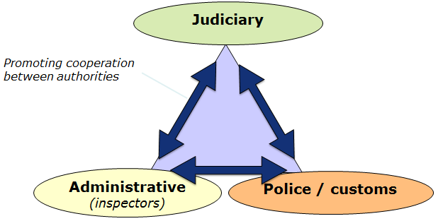











A COOPERATIVE APPROACH
TRUST
Investigative legal
powers
The EU Food
Fraud Network
Member States
Expertise/Enforcement
Intelligence
Interpol

Slide 39
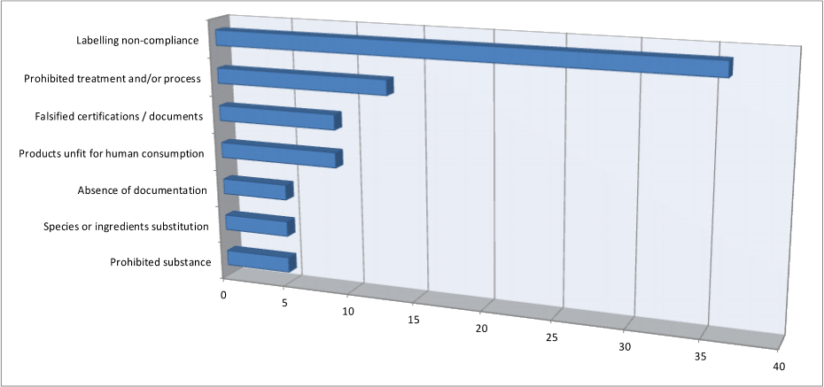
FRAUD CASES EXCHANGED VIA THE NETWORK
(since July 2013, 200+ cases)

Slide 40
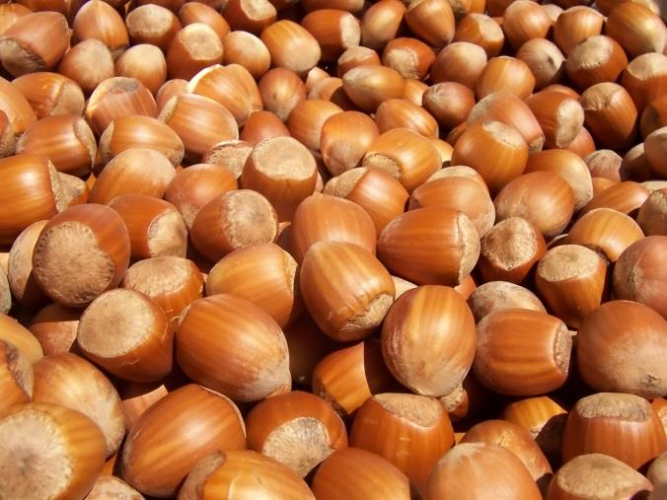
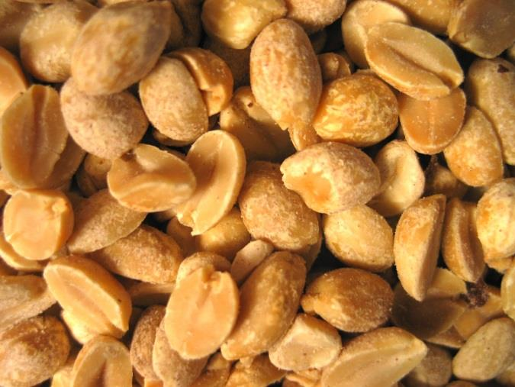


EXAMPLE OF EU-COORDINATED CASE
in the framework of art. 40 of Regulation (EC) N°
882/2004
UNDECLARED PEANUTS IN GROUND
ROASTED HAZELNUTS FROM GEORGIA

Slide 41







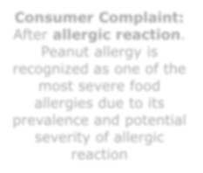



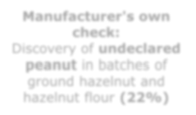










Consumer Complaint:
After allergic reaction.
Peanut allergy is
recognized as one of the
most severe food
allergies due to its
prevalence and potential
severity of allergic
reaction
Investigations
from DE
authorities:
Manufacturer's own
check:
Discovery of undeclared
peanut in batches of
ground hazelnut and
hazelnut flour (22%)
suspicion of fraud and
public health risk
AAC
Administrative assistance
and cooperation system

Slide 42






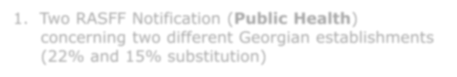





1
ECONOMIC GAIN
Market price
3.600$/Ton
Gain
400$/Ton
1.600$/Ton
2
EU COMPETENCE
1. Two RASFF Notification (Public Health)
concerning two different Georgian establishments
(22% and 15% substitution)
2. Imports from Georgia/Several MS Concerned
(art. 40 of Reg. 882/2004 on Official Controls)

Slide 43

















3
CRITERIA FOR EU COORDINATION
1. Violation of EU Food Law
Undeclared peanuts in ground
roasted hazelnuts
2. Intention
22% and 15% substitution
3. Economic gain
400$ per Ton
Customer wants to buy only
hazelnuts. Unexpected
4. Deception of customers
allergenes (peanuts)

Slide 44




















4
EU COORDINATION
The EU Food
Fraud Network
1.
2.
Automatic alert from RASFF
Specific request for action/information
Georgia

Slide 45

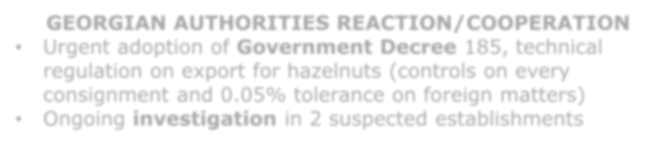

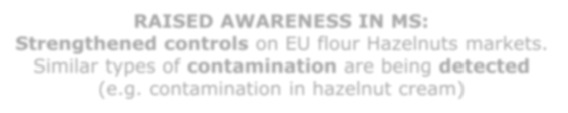
RESULTS OF EU COORDINATION after 2 MONTHS
GEORGIAN AUTHORITIES REACTION/COOPERATION
• Urgent adoption of Government Decree 185, technical
regulation on export for hazelnuts (controls on every
consignment and 0.05% tolerance on foreign matters)
• Ongoing investigation in 2 suspected establishments
RAISED AWARENESS IN MS:
Strengthened controls on EU flour Hazelnuts markets.
Similar types of contamination are being detected
(e.g. contamination in hazelnut cream)

Slide 46
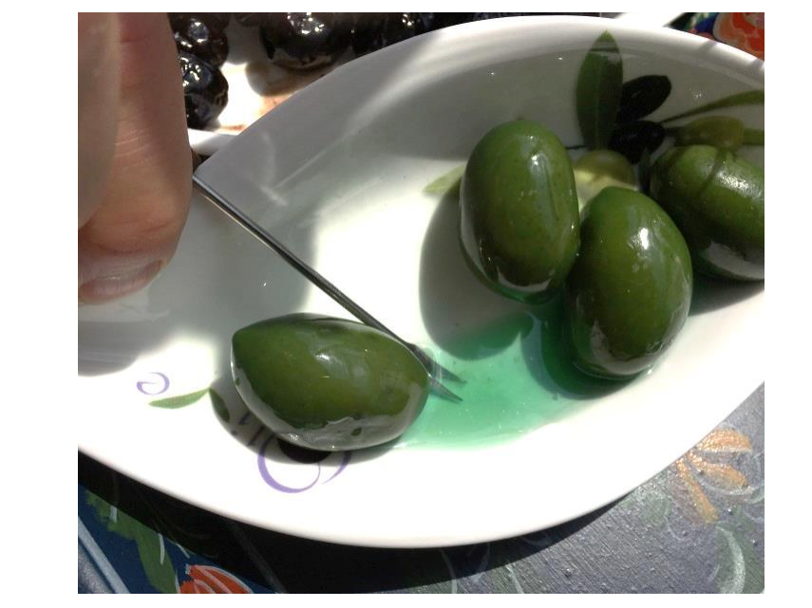
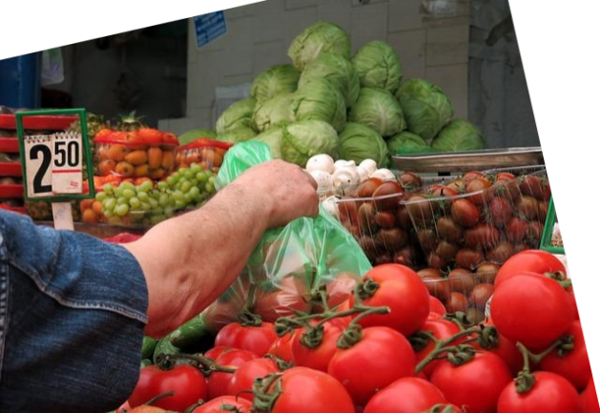


Informed consumers
Bright and Appetizing Olives!
�
But Juicy ???

Slide 47


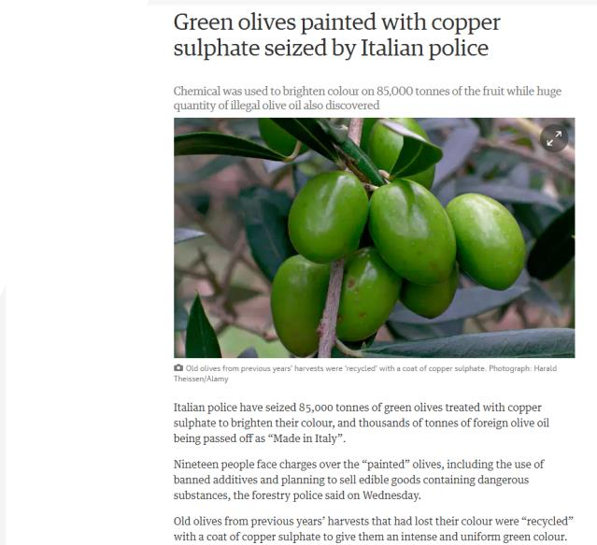
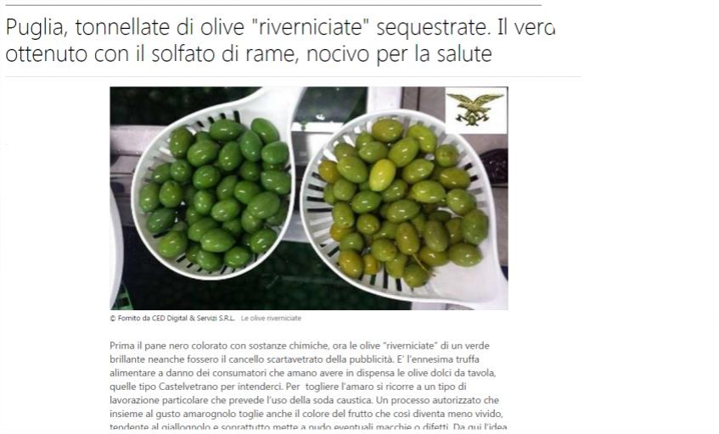


BE VIGILANT and REPORT BACK!

Slide 48










Thank you for your attention!
And DO NOT FORGET
FOOD IN THE EU HAS NEVER BEEN SAFER!

Slide 50


Slide 51



Food Fraud en Food
Integrity in The
Netherlands
Dr Harry Paul, inspector-general
Netherlands Food and Consumer
Product Safety Authority
24 June 2016

Slide 52




Food safety and integrity in The Netherlands
Regulation
Ministry of Health,
Welfare and Sports:
• Food
• Consumer
Ministry of Economic
Affairs
•
•
•
Agriculture
Slaughter houses
Freeze houses
2
24 June 2016

Slide 53
Food safety and integrity in The Netherlands
Surveillance, Detection and Enforcement
Netherlands Food and Consumer Product Safety Authority (NVWA)
• Surveillance and enforcement (administrative & criminal law)
• NVWA-IOD: intelligence and investigation (criminal law)
Important: For food-, feed- and animal related issues all these
activities are in one organisation: NVWA (and NVWA-IOD).
The NVWA-IOD is working together with the Public Prosecutor in
food-, feed- or animal related issues.
3
24 June 2016

Slide 54


Our investigations: food and non-food
• Horsegate cases
•Illegal transport of manure
•Bone meal (BSE risk)
• Shellfish recall/origin fraud
•Blood sample fraud (export
certification fraud)
• Illegal import Chinese pork
in dim sum
•Falsified certificates for
fairground attractions
• Free range egg fraud
•Illegal dog trade (internet
investigation)
• (Perishable) cheese
•Fish quota fraud
• Antibiotics in poultry
• Illegal slaughter
• Fraud with fish species
• Counterfeit pesticides
• Illegal growth hormones
4
4
24 June 2016

Slide 55
Food safety vs food fraud
1
2
Food safety
3
4
5
Food Fraud
5
24 June 2016

Slide 56

6
24 June 2016

Slide 57

7
24 June 2016

Slide 58

8
24 June 2016

Slide 59

9
24 June 2016

Slide 60
GENERAL FOOD LAW
Article 17: “Food business operators at all
stages of production, processing and
distribution within the business under their
control shall ensure that foods or feeds
satisfy the requirements of food law which
are relevant to their activities and shall verify
that such requirements are met”
10
24 June 2016

Slide 61
GENERAL FOOD LAW
Article 19: Food business operators are
responsible for withdrawing food that is not in
compliance with the food safety
requirements, inform the consumers, inform
the competent authorities and collaborate
with these authorities
11
24 June 2016

Slide 62


Slide 64


Slide 65


FOOD CRIME
The British Experience
Andy Morling
Head of Food Crime
UK Food Standards Agency
@NFCULondon

Slide 66


Slide 67
The need for national leadership
The need for a proactive approach
The need for appropriately severe punishment
Food crime is a new criminal typology.

Slide 68

June 2012 June 2016

Slide 69
Food crime (noun)
Serious dishonesty that impacts
detrimentally on either the safety or the authenticity of food.
2. Any meal prepared by Andy Morling.

Slide 70
THE FOOD OFFENDING PYRAMID
OCG
FOOD CRIME
FOOD FRAUD
REGULATORY NON-COMPLIANCE

Slide 71
PRODUCTION
RETAIL
LOGISTICS
DISPOSAL
Controlling mind
Insider
Noble cause actor
External actor
Career criminal.

Slide 72

THREAT
HARM
HARM
HARM
RISK
VULNER-ABILITY
NO
KNOWLEDGE

Slide 73
Lessons from history
Natural surveillance – see something, say something
Multi-sector vigilance
Foregrounding ethics - making it industry’s problem
Incentivising informers
Detection algorithms
Dedicated law enforcement response
Zero tolerance.

Slide 74
STRATEGIC KNOWLEDGE
TARGET DISCOVERY
CASE DEVELOPMENT
INTERVENTION
LEARNING

Slide 75

OPEN
SOURCE
DATA
CLOSED SOURCE
DATA
INDUSTRY
INFORMATION
HUMINT
Notes:
The fuel that drives the

Slide 76

MEANS
MOTIVATION
OPPORTUNITY

Slide 77





  Food criminal
  Lawful food business operator

Slide 78


Thank you
@NFCULondon
andy.morling@foodstandards.gsi.gov.uk

Slide 79


Slide 80



Chris Elliott
Institute for Global Food Security
Queen’s University, Belfast
www.foodintegrity.eu
SC2 A competitive food industry Healthy and safe foods and diets for all

Slide 81

Aims
To provide Europe with a state of the art and integrated capability for detecting fraud and assuring the integrity of the food chain
To provide a sustainable body of expertise that can inform high level stakeholder platforms on food fraud / authenticity issues and priorities
To bridge previous research activities, assess capability gaps, commission research and inform EU future research needs
ADDING VALUE TO THE EUROPEAN AGRI-FOOD ECONOMY BY PROVIDING FOOD SAFETY, AUTHENTICITY AND QUALITY ASSURANCE

Slide 82







































FoodIntegrity Project: 2014-2018
€12M (€9M EC contribution) FP7 project with 38 partners (+25 new in July 2016)
Research Organisation
University
SME
Enterprise
Public Body

Slide 83
Key Outputs: progress at M30/60
  Global independent network of experts
  Scientific opinions to support regulations and enforcement
  Stakeholder secure forum
  Food integrity database hub
  Harmonisation/consolidation of existing methods / databases
  Identifying research gaps
Expertise
Evidence
R&D
Innovation
Impact
  Anticipating food fraud: early warning system
  Development of new analytical and screening methods for olive oil, fish, spirit drinks
  Commissioning €3M of new research
  Industry integration
  Global perspective (consumer behaviour at export)
  Knowledge/technologytransfer and dissemination

Slide 84



1st Outputs
3 x FI Conferences
Global focal point, >250 attendees
FI Network
Chinese consumer survey
>200 Members from 36 Countries
Procurement of €3M of new research

Slide 85
Procurement of €3M of new research (WP9)
Results of Procurement Call
  Call opened 24/06/15
  Closed 14/08/15
  83 initial expressions of interest
  27 proposals submitted
    2 proposals - FI01 - Standardisation and harmonisation of untargeted food integrity methods – 1 selected
    7 proposals - FI02 - Innovative approaches to assure the integrity of complex foods – 3 selected
    7 proposals - FI03 - A feasibility study of how information can be shared along the supply chain to identify risks to the integrity of food – 2 selected
    11 proposals - FI04 - Rapid, on-site, cost effective methods for feed/food fraud detection - 2 selected
  Negotiation complete, 8 contracts awaiting signoff (DoW)

Slide 86















FI Network (WP1)
Scientific Opinions
...researchers..regulators...enforces...consumers... ...producers...distributers...processors...retailers...
Stakeholders
Network
Experts
Partners
Scientific Opinions
SO1 Use IRMS of geo-origin
SO2 Testing in Risk Man.
SO3 Targeted >non-targeted
SO4 Multi-variate statistics
SO5 Database use &Curation
SO6 Application of NMR
SO7 Application of NGS
Workshops:
Stakeholders -Brussels 2014
Industry- Lodi 2015
Food Analysts- Bilbao 2015
Food Crime- Prague 2016
Industry- Prague 2016
FI Portal
Workshops/videos
EU Food Fraud Network
C4S
WP2
WP3
WP8
FI Advisory Board

Slide 87

The FoodIntegrity Knowledge Base (WP2)
Mapping of analytical methods for the detection of fraud and/or verification of integrity onto specific commodities or food authenticity issues
Open source for industry and control bodies
Is it organic? PDO, PGI?
Adulterated? Diluted?
Enhanced? Counterfeit?
Food Commodity or Ingredient
Inventory of authentic reference data sets
Fraud/Authenticity Issue
Analytical Method
Inventory of existing analytical tools
Analytical Reference data

Slide 88
Click on the down arrow to select from list
WP 2 – Knowledge Base
Data entry screen
FOOD COMMODITY
Food Category
Select from drop-down list
(Select commodity) 
Commodity Detail
Enter as free text – e.g. butter
CN code
FOOD INTEGRITY ISSUE
Description
Add as free text to
describe the issue
Type of fraud
Select one
Dilution
Substitution
Concealment
Mislabelling
Unapproved enhancement
Grey market
Counterfeiting
Other
Issue
Select one or more
Product composition
Geographical origin
Botanical/Cultivar/Varietal/Species
Production system/process
Product quality
Other issue
Importance Incidence: very often often rare no longer encountered
Location in supply chain: Agricultural producer Storage/transport Food manufacturer Trader Distributer
Wholesaler Retailer Unknown
Next screen

Slide 89
Select commodity – Honey and royal jelly
WP 2 – Knowledge Base
Data entry screen
Then type in details about the commodity
FOOD COMMODITY
Food Category
Select from drop-down list
(Select commodity) 
Commodity Detail
Enter as free text – e.g. butter
Animal products
Eggs and egg products
Honey and royal jelly
Meat and edible offal
Milk and milk products
Seafood
Bivalve molluscs
Crustaceans
Fish
Seaweed
Surimi
Other sea food
Fruits and vegetables
FOOD INTEGRITY ISSUE
Description
Add as free text to
describe the issue
Type of fraud
Select one
Dilution, substitution
Concealment
Unapproved enhancement
Mislabelling
Grey market, counterfeiting
Issue
Select one or more
Product composition
Geographical origin
Botanical/Cultivar/Varietal origin
Production system
Product processing
Product quality
Other issue
Importance Incidence: very often often rare no longer encountered
Level: consumer producer both
Next screen

Slide 90
Then describe the issue in more detail
WP 2 – Knowledge Base
Data entry screen
FOOD COMMODITY
Food Category
Select from drop-down list
Honey and royal jelly
Commodity Detail
Enter as free text – e.g. butter
Royal jelly
FOOD INTEGRITY ISSUE
Define the type of fraud, round buttons allow only one choice
Description
Add as free text to
describe the issue
Royal jelly produced from non-authentic saccharide sources
Type of fraud
Select one
Dilution
Substitution
Concealment
Mislabelling
Unapproved enhancement
Grey market
Counterfeiting
Other
Issue
Select one or more
Product composition
Geographical origin
Botanical/Cultivar/Varietal/Species
Production system/process
Product quality
Other issue
Then define the issue, square boxes allow multiple selections
Importance Incidence: very often often rare no longer encountered
Location in supply chain: Agricultural producer Storage/transport Food manufacturer Trader Distributer
Wholesaler Retailer Unknown
Next screen

Slide 91


Food Integrity Website

Slide 92
Impact
Impact
Expected Impact | FI Impact | Relevant FI Output
Increasing EU added value through the concept of Food Integrity | Improved capability of stakeholders wrt food fraud, comms, systems, methods, intelligence | KB, Network, workshops, Early Warning Systems (EWS), rapid methods, improved food assurance. Scientific Opinions, Dissemination and promotion of FI concept.
Strengthen the competitiveness of EU food producers | FI systems and outputs help protect industry added value. | Industry implementation. Rapid methods, assurance systems, EWS, improved understanding of consumer attitudes to EU exports.
Improved communication of quality attributes | Improved understanding of attitudes, preferences and expectations for European and Chinese consumers | Consumer behaviour study in China. Toolbox for EU exporters to China
Reduce trading blocks | Enhanced assurance of EU products will reduce likelihood of counterfeit EU products being on sale in foreign markets. | Fit for purpose industry assurance applications and systems. Enhanced knowledge of food authenticity issues, risks and mitigation strategies.
Restore consumer confidence | Stakeholders embrace FI concept and implement strategy | Dissemination and engagement activities (network, workshops, social media) with input from Industry and Consumer groups (Which?)
Support EU Policies | Provide input into EU for and committees | Strong active links with DG Agri, DG Sante, DG Research, JRC’s, EFSA.

Slide 93
Lessons learnt
Successes | Challenges
Stakeholder engagement | Stakeholder patience (research project not operational activity)
Excellent consortium- delivering | Procurement of new research (€3M) slow and resource intensive
Bringing together of the disparate actors in the food chain to assure the food supply | Financial inefficiency of the procedures available to incorporate new partners into FI
Exporting FoodIntegrity- strong links with China, SE Asia, US | Yet to engage with India, Russia,
Exploiting the relatively large resources available to FI- ability to influence/act | Bureaucracy associated with managing 38 soon to be 63 partners
Sustainability of project components | Sustainability of project components

Slide 94




How to Get Involved
Join FoodIntegrity network
Visit FoodIntegrity website
www.foodintegrity.eu
E-mail FoodIntegrity
foodintegrity@fera.gsi.gov.uk

Slide 95






Parma, Italy 10-11 May 2017
FOODINTEGRITY 2017
“Assuring the integrity of the food chain: turning science into solutions”
SAVE THE DATE!

Slide 96


Acknowledgements
This project has received funding from the European Union’s Seventh Framework Programme for research, technological development and demonstration under grant agreement nº 613688

