Slide 2
Consumer
attitudes
towards labelling
Dr Tim Gumbel, Deputy Head of
Unit, DG SANTE E1,
European Commission
High level conference on food
authenticity and food integrity
Brussels 24 June 2016

Slide 3
Labelling – function and responsibilities
• Labelling/ food information in general - tools
• Labelling – other factors relevant for choice
• Consumers' right to information
• Informed choice – economic, environmental, social
and ethical considerations
• Health protection (balanced diet/ safety)
• Internal market
• Responsibility of food business operator

Slide 4
Labelling – part of the overall toolbox
• Labelling vs. traceability
• Traceability – risk management tool (food safety,
action in case of risk –withdrawal/recall,
prevention of wider trade disruption)
• Relevance for consumers: distinction between
affected and non-affected products
• Implementation/ beneficial effects – fitness check
• Other tools: responsibilities of food business
operators, transparency/ role of controls

Slide 5
Actual perception of labels by consumers
• Labels – understanding:
• Eurobarometer 342 on consumer empowerment, 2011:
60% of consumers interpret nutrition information
correctly
• Study on the functioning of voluntary food labelling
schemes, 2013: 40% of consumers find references to
scheme/ logo hard to understand
• Eurobarometer 440 on CAP, 2015: 67% of consumers
recognise quality labels/logos
• Flash Eurobarometer 425 on food waste and date
marking, 2015: 53% /60% of consumers do not
understand date marking on food labels correctly

Slide 6
Consumer expectations
• Labelling
• Clear, precise and truthful information regarding
authenticity, composition, properties, innovative
aspects, origin, compliance with standards
• Origin information – discrepancy actual/ affirmed
choices
• Potentially interesting, voluntary information:
production methods (welfare, sustainability)
• Last step in the chain/ distinction from
information passed on at earlier stages

Slide 7
Conclusions
• Function of labels/ other tools to ensure integrity
• Proper consumer understanding necessary basis
• Consumers are market actors, different
expectations/ motivation of different consumer
groups
• Future – foresight study "EU food safety and
nutrition 2050"- non-verbal information or encoded
information accessible in various languages?

Slide 9
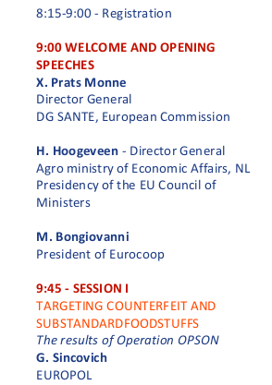
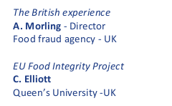
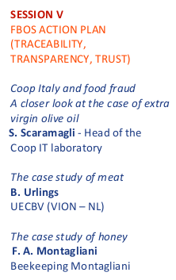
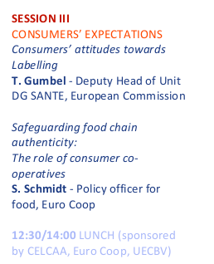
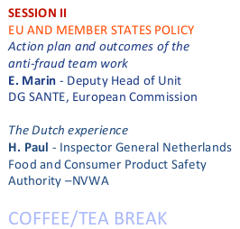

Slide 11
European Community of Consumer Cooperatives
Safeguarding food chain authenticity:
The role of consumer co-operatives
High Level Conference on Food Authenticity and Integrity
24 June 2016
Silvia Schmidt
Policy Officer for Food and Retail

Slide 12
European Community of Consumer Cooperatives
Overview
Overview of Euro Coop and the co-operative difference
2. Co-op consumers expectations and trends
3. Members’ initiatives
4. Conclusions

Slide 13
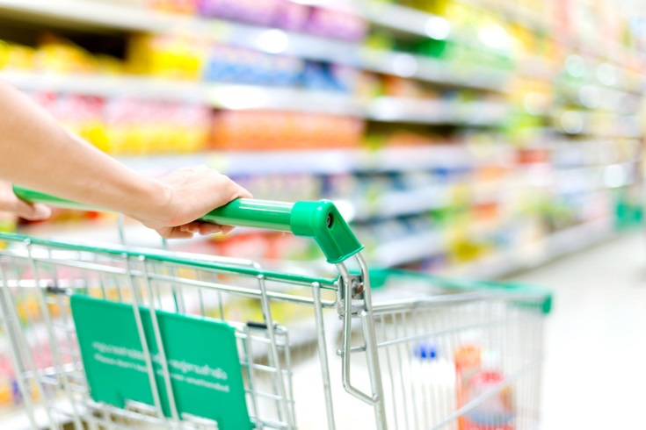
European Community of Consumer Cooperatives
Overview of Euro Coop
General Facts
European association of consumer co-operatives
Members: national consumer co-operative organizations in 19 countries
Members’ main activity: retail
General Numbers
5,000 local consumer co-operatives
500,000 employees
36,000 stores
32 million consumer-members
> € 76 billion annual retail turnover

Slide 14
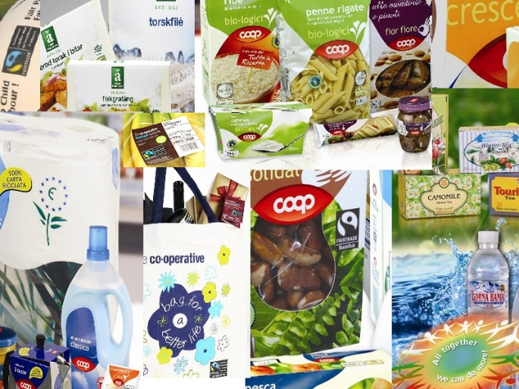
European Community of Consumer Cooperatives
Euro Coop’s main activities
Represent the members before the EU Institutions
Member of the EU Platform for Action on Diet, Physical Activity and Health
Exchange of experiences, best practices, know-how
Providing information on key policy issues
www.eurocoop.coop

Slide 15
European Community of Consumer Cooperatives
The Co-operative Difference (1/2)
Different entrepreneurial model based on
values and principles
VALUES →

Slide 16
European Community of Consumer Cooperatives
The Co-operative Difference (2/2)
PRINCIPLES:
Voluntary and Open Membership
Democratic Member Control
Member Economic Participation
Autonomy and Independence
Education, Training, and Information
Co-operation among Co-operatives
Concern for Community

Slide 17
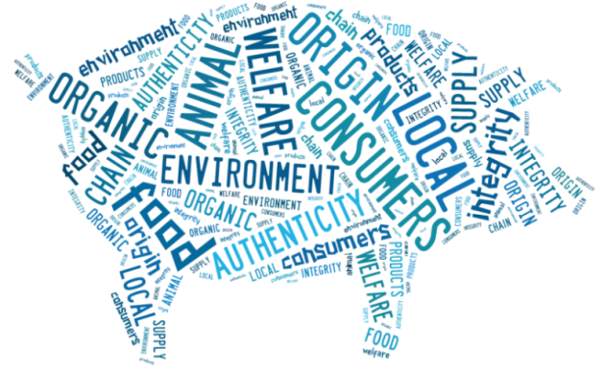
European Community of Consumer Cooperatives
Co-op consumers expectations and trends
Increased interest in local foods
Consumers want to know where their food comes from
Traceability, more transparency
Consumers expect fairness in the supply chain
Need to counteract potential fraudulent practices
Authenticity and integrity
Increased attention payed to animal health and welfare
Concern about the environment
Increased interest in organic products

Slide 18
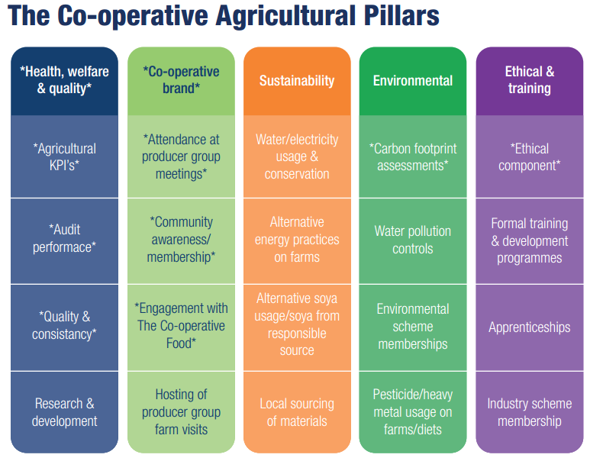
European Community of Consumer Cooperatives
The Co-operative Group
Support for UK farming industry and local foods
Farming groups
2000+ farmers, close cooperation with 400 → Co-op farming groups
Own brand chicken, pork, Hereford and Aberdeen Angus beef, Cambrian lamb, milk
Gold, Silver, Bronze farms → Premiums
Responsible sourcing
Only free range own brand eggs
Own brand fish range; members of the sustainable seafood coalition (SSC)
All own brand turkeys labelled with Red Tractor Logo and Quality British Turkey Mark
→ High standard of food safety, traceability, animal welfare
→ Inspection of farms, external risk assessments

Slide 19
European Community of Consumer Cooperatives
Coop Denmark
Quality and safety
Own brand often subjected to stricter standards than the law
High emphasis on self-monitoring and training
“Quality assured by Coop” = product and content, composition, testing (incl. taste)
Coop suppliers must also be approved
Local products – Accountability
Support Danish food production
Many local partnerships in 2015
Änglamark
red Ø or the EU logo

Slide 20
European Community of Consumer Cooperatives
Coop Sweden
Änglamark – focus on organic and traceability
Coop fishing strategy (quota)
Promotion of traceability in Baltic Sea and West Coast through Närfiskat
Suppliers must report fish species and how it was caught
Suppliers of farmed fish must present farming methods and animal feed
No endangered species
“From Sweden” label (April 2016)
Voluntary origin label; Coop one of driving forces
Criteria:
Animals must be born, raised and slaughtered in Sweden
Cultivation should have taken place in Sweden
All processing and packaging must take place in Sweden
Currently used for Coop dairy products, 400 products should bear the label by the end of the year

Slide 21
European Community of Consumer Cooperatives
S Group (Finland)
Product safety
Product safety certifications and audits in accordance with Global Food Safety Initiative
Transparency – own brands
Country of manufacture + country of origin of product’s main raw material for range Kotimaista and X-tra lines
Monitoring
Third party audits (external) + internal audits and on-site visits
Production must comply with legislative and stricter S Group requirements
Collective labour agreements, human rights
Notes:
Product safety
The safety of food products is ensured by means of product safety certifications and audits in accordance with the Global Food Safety Initiative (GFSI). Product safety audits cover the supplier's self-control system regarding, among other things, how product quality is ensured during the manufacturing process from raw materials all the way to the end products. Deviations detected through self-control or audits are corrected in cooperation with the supplier.

Slide 22
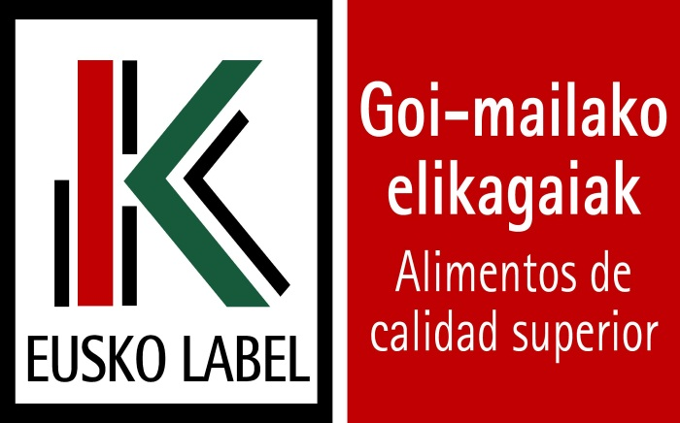
European Community of Consumer Cooperatives
Eroski (Spain)
EROSKI NATUR – own brand
Guarantee for consumers
Controls from field to store
Geographical indications and national quality labels
Collaboration with more than 5000 local Spanish suppliers
EUSKO label
“Agri-food products which are produced, processed and/or prepared in the Basque Country”
“Fully secure identification of the origin and authenticity of products”
15 products; online

Slide 23
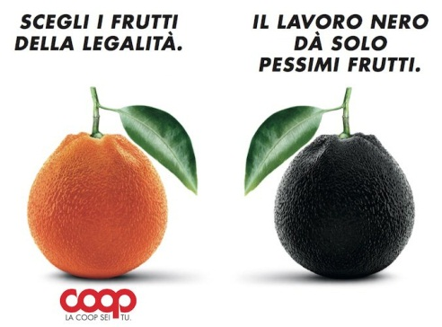
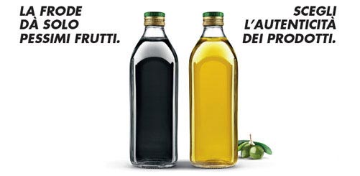
European Community of Consumer Cooperatives
Coop Italy (1/2)
Quality and safety
Own brand monitoring, but also control on non own brand products
In 2014, 25.859 controls on foodstuffs from 979 suppliers
Co-op suppliers must comply with strict own standards → inspector give good / improvable / critic evaluation every year
Collaboration with universities, laboratories, scientific and research institutes to ensure accurate controls and prevent potential emerging risks
Buoni e Giusti
Strawberries
Clementines and oranges
Olive oil (“super nose”)

Slide 24
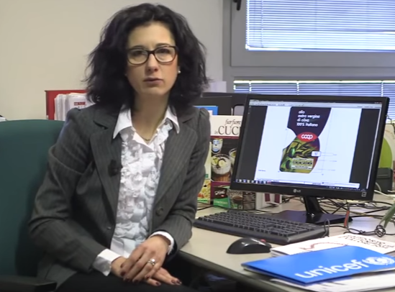
European Community of Consumer Cooperatives
Coop Italy (2/2)
Traceability – Own brands
Close cooperation with every step of the chain → full traceability possible
Every actor signs specific contractual commitments and is subject to stringent specifications
Inspections and analysis of different parties involved
Range “origine”, e.g. (pre-packed) cold cuts, cheese..
Video
Interview with Ms. Chiara Faenza
Coordinator at the R&D Department

Slide 25
European Community of Consumer Cooperatives
Conclusions
We see an increase in “local” through labelling, direct sourcing, close cooperation with suppliers
Improved traceability → Increase consumer confidence
Support local economy
There should be evidence that self-regulation alone is enough to counteract fraudulent practices
Harmonization of control systems and laboratory techniques
Higher emphasis on implementation and enforcement; imports
Communication, collaboration and sharing of best practices
Innovation

Slide 26
European Community of Consumer Cooperatives
Thank you for your attention!
For more information:
Euro Coop website: www.eurocoop.coop
E-mail at sschmidt@eurocoop.coop

Slide 29
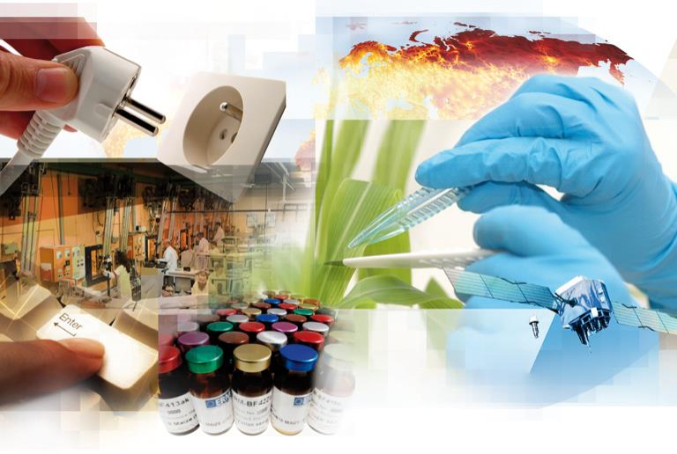
Detection of food fraud: the analytical
challenge
F. Ulberth
www.jrc.ec.europa.eu
Serving society
Stimulating innovation
Supporting legislation

Slide 30
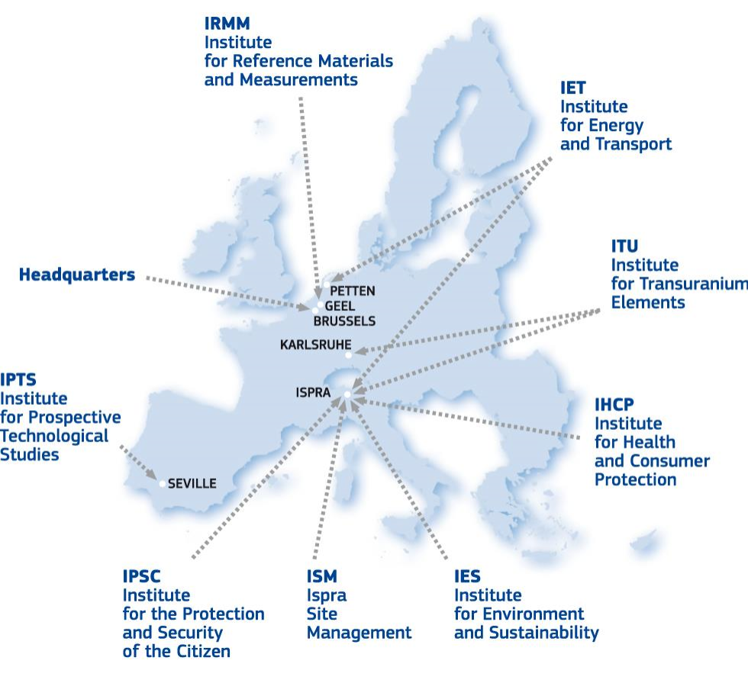
The Joint Research Centre (JRC)
• European Commission’s
in-house science service
• Supporting EU policies with
independent, evidence-based
scientific and technical support
• ~ 3.000 staff (2014)
• 6 locations
2

Slide 31
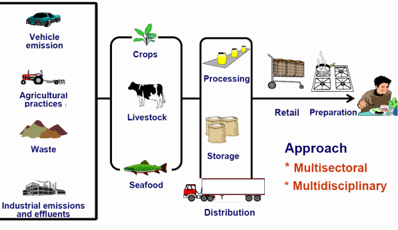
Food supply chain
• Numerous possible routes
for illicit manipulations
• Each link in the chain is
responsible for the quality
and safety of its products
• Coordination of intervention
and control strategies
•Communication between
many stakeholders

Slide 32
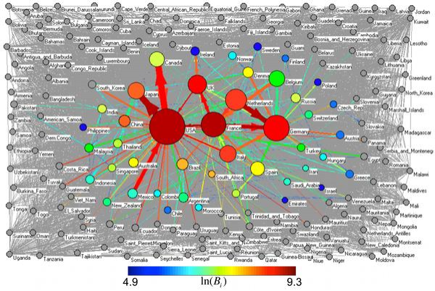
Source: Ercsey-Ravasz M, Toroczkai Z, Lakner Z, Baranyi J (2012) Complexity of the International Agro-Food
Trade Network and Its Impact on Food Safety. PLoS ONE 7(5): e37810. doi:10.1371/journal.pone.0037810,
p.2.
4

Slide 33
Key characteristics of food fraud:
1. non-compliance with food law and/or misleading the
consumer
2. which is done intentionally
3. for reasons of financial gain.
22 June 2016
5

Slide 34
Main types of food fraud
•
sale of food which is unfit for consumption and potentially
harmful,
• knowingly selling goods which are past their 'use by' date,
•
deliberate misdescription of food, such as: products substituted
with a cheaper alternative, for example, farmed salmon sold as
wild, and Basmati rice adulterated with cheaper varieties
• making false statements about the source of ingredients, i.e.
their geographic, plant or animal origin
22 June 2016
6

Slide 35
Recent examples
Adulterant | Analytical solution
Sudan dyes in spices | Chromatography
Melamine in milk powder | Chromatography
Horsemeat in beef | PCR
Gelatine in chicken breast | Proteomics
Misdescription of fish species | PCR, DNA bar coding
Conventional food/organic food | HPLC, stable isotopes, etc
Seed oils in olive oil | Chromatography
Cow's milk added to sheep's milk | Electrophoresis
Adulteration of fruit juices | Chromatography, stable isotopes, SNIF-NMR
Adulteration of wine | NMR, stable isotopes
22 June 2016
7

Slide 36
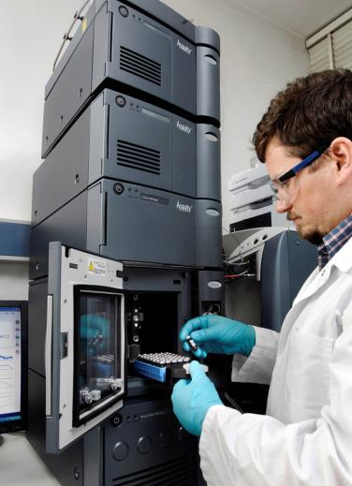
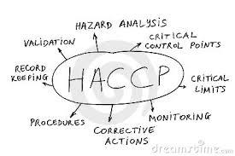
What we need
Chemistry
Suitable, validated analytical method(s)
Reference materials/substances/data
Forensics
Criminological characteristics of food fraud
Horizon-scans and intelligence gathering
Whistle blowing
Management
Vulnerability analysis
Risk management
22 June 2016
8

Slide 37
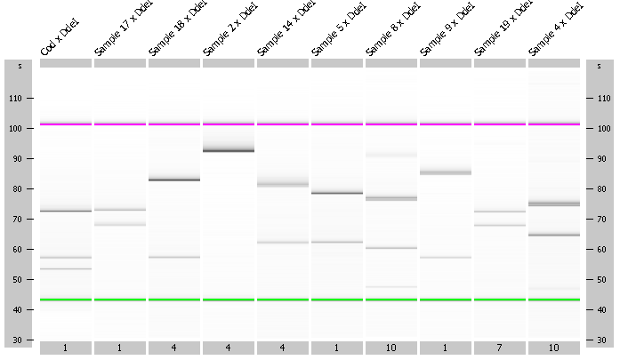
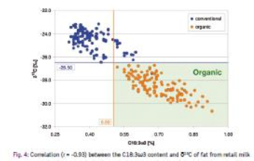
Strategies to detect fraud
Fundamental difference
Empirical difference
22 June 2016
9

Slide 38
Targeted – untargeted analysis
22 June 2016
10

Slide 39
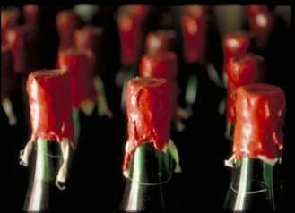
European Reference
Centre for Control in the
Wine Sector ( DG AGRI)
22 June 2016
11

Slide 40
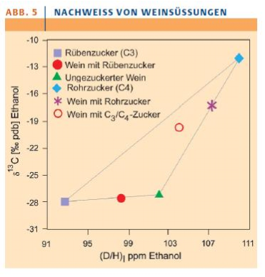
Adulteration of wine
•
Isotopic analysis for detection of
sugaring (chaptalisation) and
watering of wine, and geographical
origin of wine
• SNIF -NMR: determination of the
®
• δ
13
C of ethanol
• δ O of wine water
18
European Reference Centre for
Control in the Wine Sector
(operated by JRC)
Schmidt et al, 2005
22 June 2016
12

Slide 41
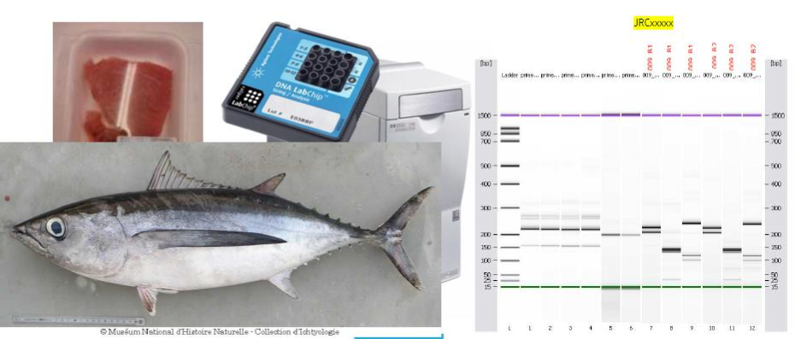
Fish substitution
22 June 2016
13

Slide 42
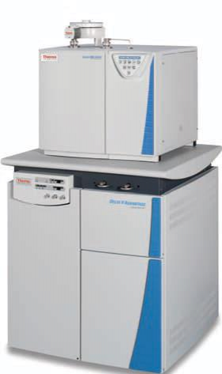
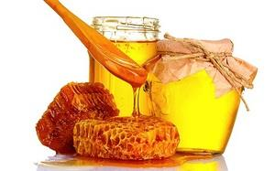
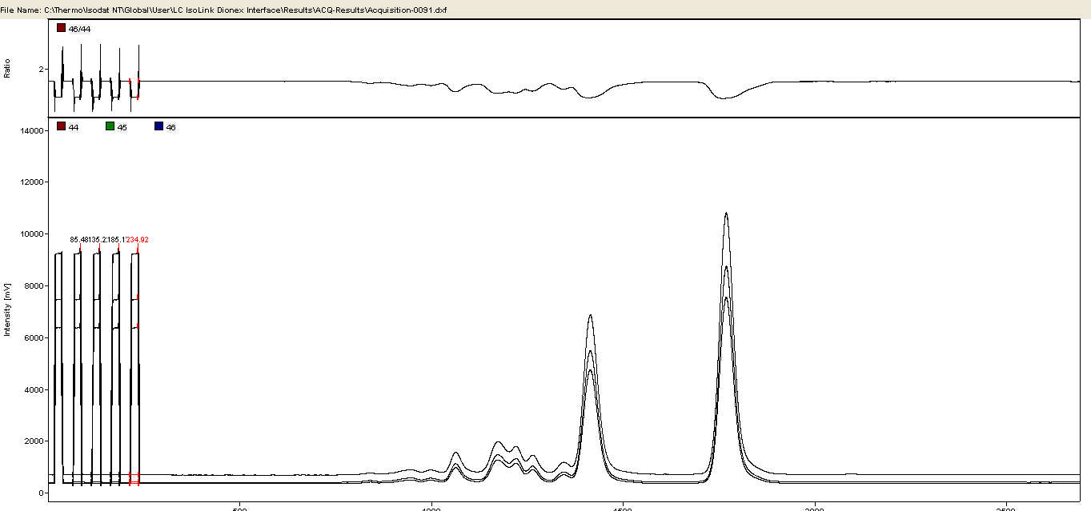
Honey extension
22 June 2016
14

Slide 43
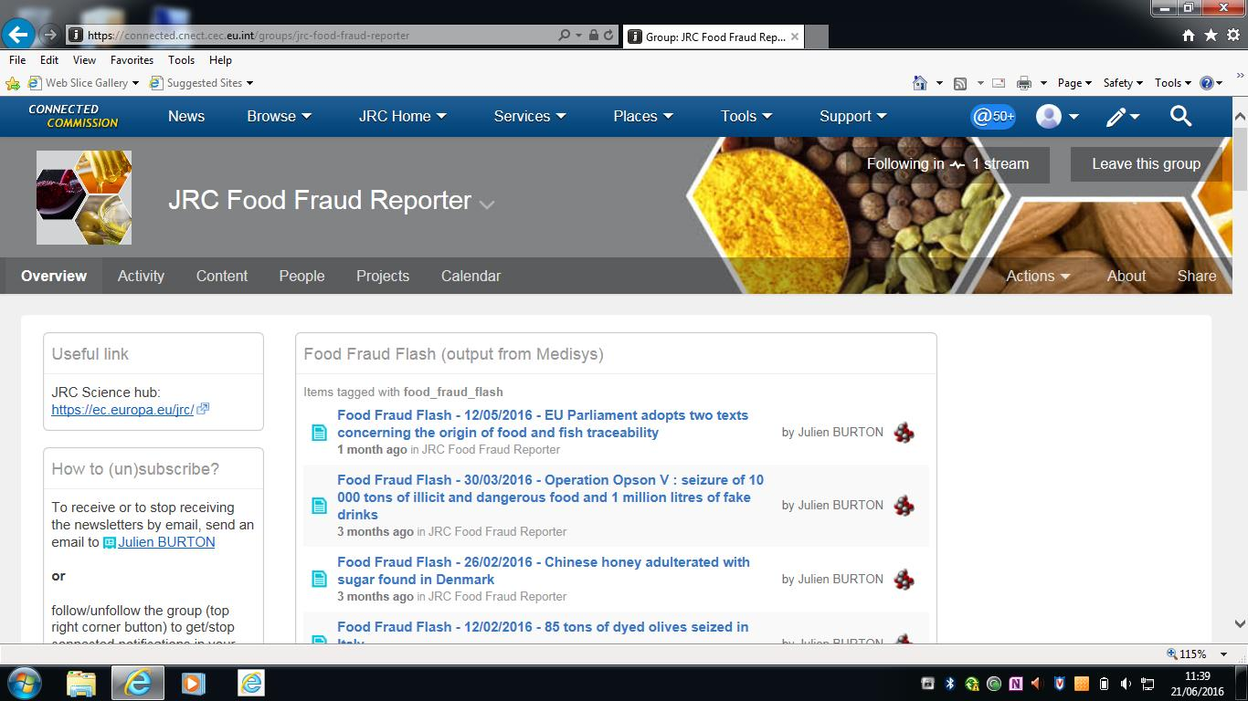
22 June 2016
15

Slide 44
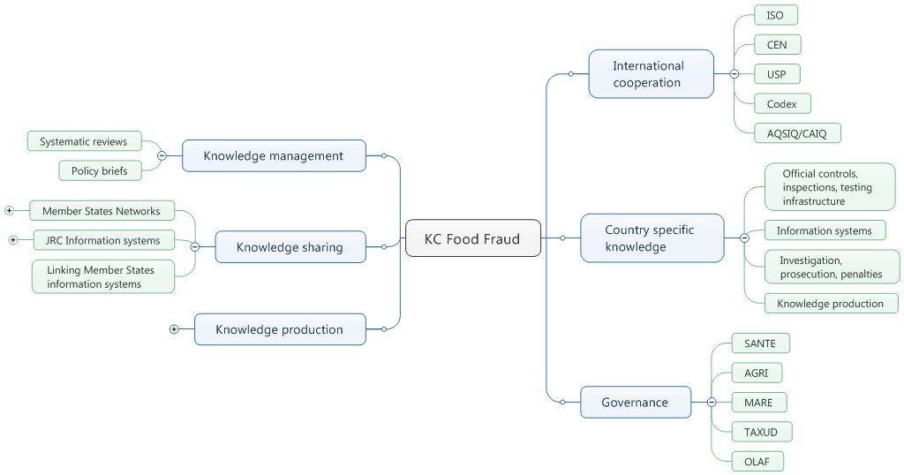
JRC Knowledge Centre for Food Authenticity
22 June 2016
16

Slide 45
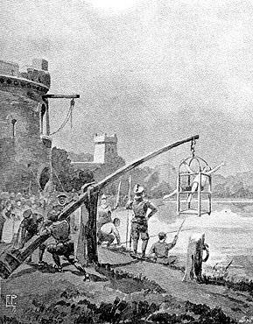
22 June 2016
17

Slide 46
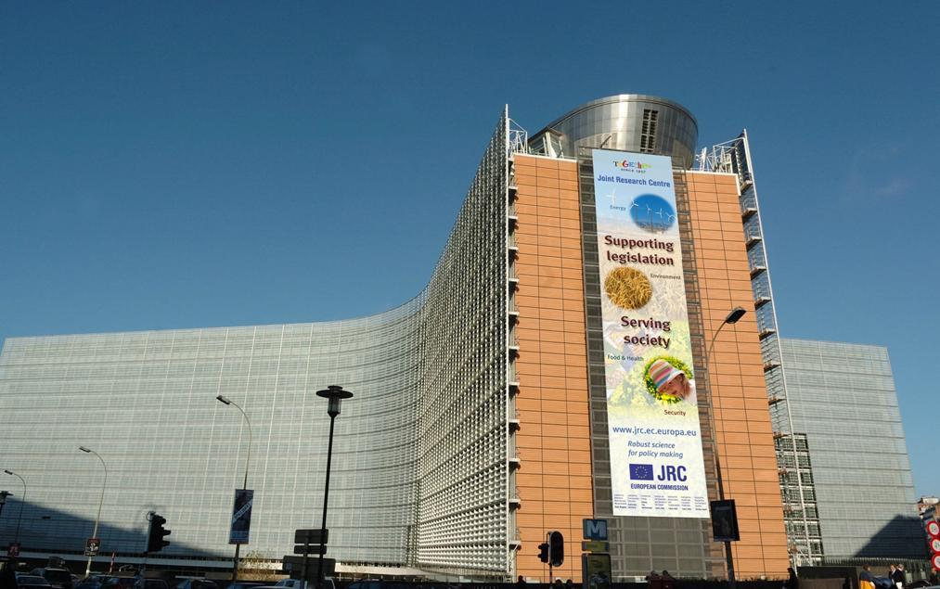
Joint Research Centre (JRC)
www.jrc.ec.europa.eu
Contact: franz.ulberth@ec.europa.eu
Serving society
Stimulating innovation
Supporting legislation
22 June 2016
18

Slide 49
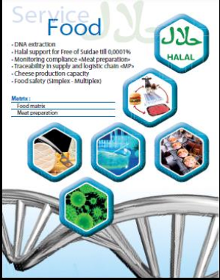
EU conference – 24th of June 2016
Food fraud prevention
Can science help us avoid a crisis?
Prof. Robert Renaville
Gembloux Agro-BioTech, ULg
CEO of Progenus s.a.

Slide 50
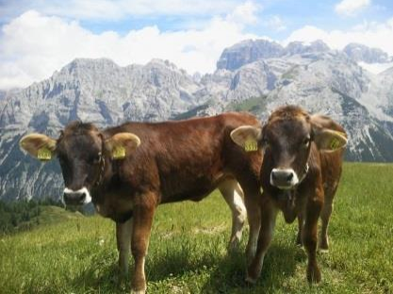
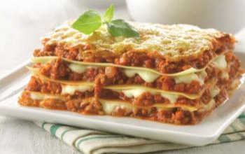
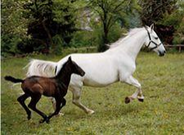
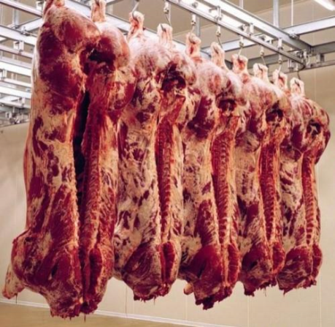
Why should we test for species authenticity?
?
OR
NOW
BEFORE

Slide 51
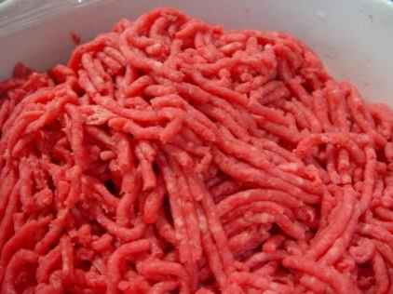
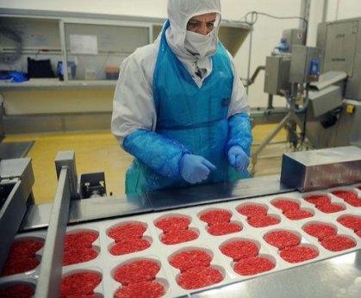
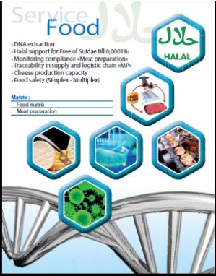
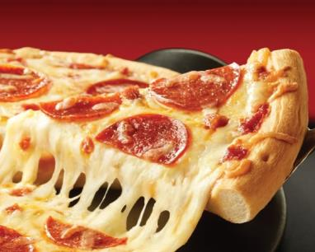
3 Questions ...
Can I control my suppliers?
 | chain
Can I check the cleaning of my production
previous production lots?
from
As a consumer, can I trust what I eat?

Slide 52
… 2 technical answers
First step : DNA detection by qPCR methods
Is there any undesired species in my food?
Ex : horse in beef hamburger

Slide 53
… 2 technical answers
Second step : quantification
Do I fit with the legislation : <1% or >1%?
Is the minced meat supplied, really 40 pig/60 beef ?

Slide 54
4 quantification approaches
Dilution |  | EU |  | ∑ |  | Easyfast™
curve |  | method |  | species |  | test
Dilution curve
Principle : DNA is extracted from meat and serially diluted in buffer. Horse
percentage in the unknown sample is extrapolated from this standard curve
29
27
25
23
qPCR results
21
19
Unknown sample
17
15
0,1
1
10
100
Horse %
No account of matrix effect

Slide 55
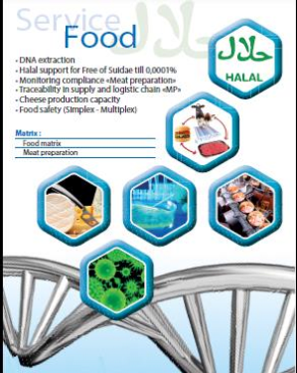
4 quantification approaches
Dilution |  | EU |  | ∑ |  | Easyfast™
curve |  | method |  | species |  | test
EU method
Principle : DNA is extracted from beef meat with 1% of horse meat,
unknown samples are compared to this reference
29
 |  | < 1%
 |  | > 1%
27
< 1%
25
23
qPCR results
> 1%
21
19
17
15
0,1
1
Horse %
10
100
No account of technological process (heat, …)
No real quantification

Slide 56
4 quantification approaches
 |  | EU |  |  |  | ™
curve |  | method |  | species |  | test
Dilution
EU
∑
Easyfast
™
curve
method
species
test
Sum of species method
Principle : values for 7 species are added which is equaled to 100%
species | PCR results | Percentage
Beef | 50000 | 25 %
Horse | 2300 | 1%
Pig | 87000 | 43%
Goat | 56987 | 28%
Sheep | 123 | 0,06%
Chicken | 0 | 0%
Turkey | 6897 | 3%
No account of the different No account of other species
∑
efficiency of the 7 analysis

Slide 57
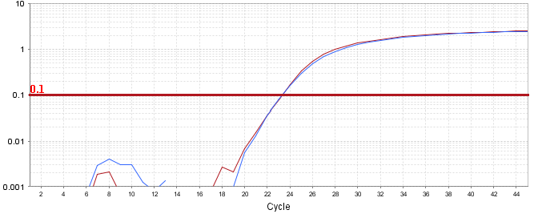
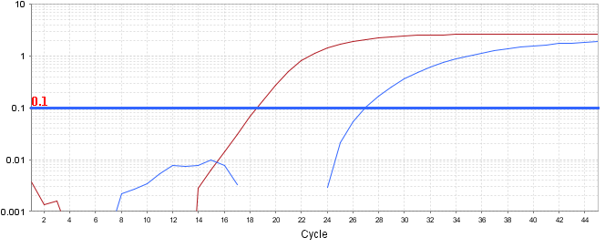
4 quantification approaches
 |  | EU |  |  |  | ™
curve |  | method |  | species |  | test
Dilution
∑
Easyfast
Progenus EasyFast™ method
Principle : the quantity of DNA of the species is quantified in % of the
quantity of vertebrate DNA
100% horse
0.3% horse
Real quantification
Accounts for technological processes & unknown species

Slide 58
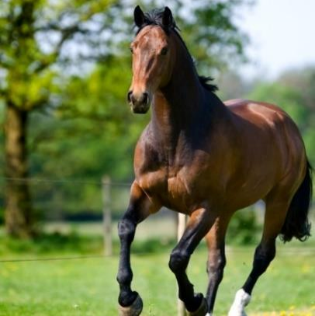
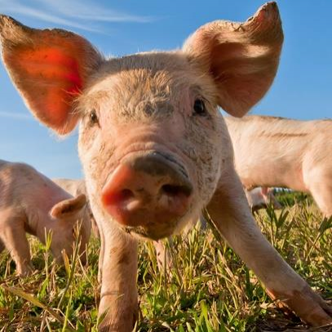
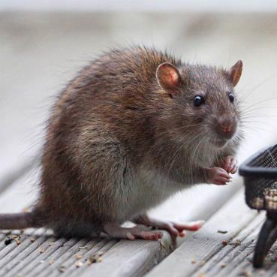
Species that can be detected and quantified
✓ Horse
✓ Pig
✓ Beef
✓ Chicken
✓ Turkey
✓ Sheep
✓ Goat
✓ Duck
✓
Dog
✓ Cat
✓ Rat
✓ …

Slide 59
Methods of quantification
 |  | EU |  |  |  | ™
curve |  | method |  | species |  | test
Dilution
∑
Easyfast
results between a low product is reported to be around 10
, | -
*The difference in quantitative DNA
processed and
a highly processed meat
-fold
(Laube et al, 2007, Int. J. Food Sci Technol 42: 336 41)

Slide 60
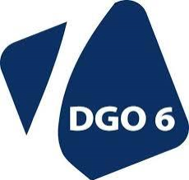
Special thanks
Contact: renaville.r@progenus.be
+ 32-(0)81-616901

Slide 84
Trust in Food: product integrity and transparency.
June 24, 2016
Bert Urlings

Slide 85
Vion Food: Farmers owned
TOP 30
Food companies
In turnover
25 Production locations
The Netherlands - Germany
Net turnover 2015
EUR 4,6 Billion
11,021 employees
3 Business Divisions
303,000 pigs processed
Per week
17,400 cattle processed
Per week
Pork
Beef
Food Service
100.000.000 consumers
every day

Slide 86
Bert Urlings

Slide 87
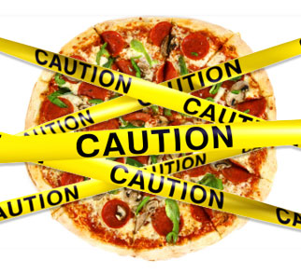
Litigation

Slide 89
What are the issues?
Public health e.g.:
Influenza
Q-fever
Antibiotic resistance
Food safety e.g.:
Salmonella / Listeria / ESTEC
Toxoplasma gondii
Antibiotic resistance ESBL
Dioxin / Aflatoxin
Animal welfare e.g.:
Castration
Transport
Environment / Labour ethics / Sustainability
Contemporary theme’s
Integrity of food: “What you see is what you get.”
Process
Product
Label
Transparency Vion:
All audits full on internet
All meat inspection data on internet

Slide 90
What are the developments in the market?
Brand owners: Reduce risks
Reduce the number of suppliers (dramatically)
Demand recognised certificates
Critical on Certification Bodies
Unannounced audits / checks
Development of second party standards Food Integrity
Marketing efforts focussed on trust in supply chain
Some retailers take the same measures
Others await GFSI

Slide 91
Challenges
Regain trust:
NGO-s
Food Scandals / Fraud
Consumer and Market wants more control
What are the key elements to address:
Animal welfare
Environment
Food Safety
Open Standard that includes also control of Chain of Custody
Part of the society: “Farming in concert with your neighbours”

Slide 92
Create trust & add value
Show that your Integrity is in control:
Chain of Custody programme:
Developed with Retail (CBL)
Certification bodies
For Animal Welfare friendly Pork programme of Dutch Retail
System needs:
Standard for Product and Process Integrity
Third party audits
Unannounced audits
Transparency:
Registered companies in the supply chain
Standard Integrity
Result:
Trustwhorty pork at retail, favoured by the Animal welfare NGOs
From 20% (2011) >>> more than 90% (end 2016)

Slide 93
Private Quality Standards
Relevant instrument to control several issues
Part of continuous improvement programmes
Create Trust Industry, Retail, OoH and Society
Detect and remove Criminals….
Unannounced audits / inspections
Integrity programmes to control the value of the label and protect the participants in the supply chain

Slide 94
Transparency
Trust: open and transparent:
Walk your talk / talk your walk
One message to all:
Customers
Authorities
Own workforce
NGO’s
Public
Publish all relevant data:
Government data
Third party audits
Projects: public health / animal welfare / integrity / sustainability etc
October 2014 decision taken to go public with these data (non sensored)

Slide 96
Internet hits

Slide 97
Conclusions
Response on openness:
Government positive, but curious awaiting
Customers, Retail, OoH all very positive
Own employees: mixed
Some NGO’s positive
Media coverage:
Just the simple fact of transparency
A few used some data
Chain of custody / Integrity standard:
Used in all fresh pork production for NL retail
Farmers receive more money for their pigs
Two retailers use CoC standard also for other products in supply chain
IFS is moving this CoC standard into a professional accredited standard for all
Trust is back again

Slide 98
Take home message
How to regain trust:
Industry is implementing a strong Chain of Custody / Integrity standard
Radical transparency

Slide 112
http://ec.europa.eu/dgs/health_food-safety/index_en.htm
http://www.eurocoop.coop/
http://www.celcaa.eu
http://www.uecbv.eu/
FOLLOW US!!!

